Slide 1
BIM-based semantic enrichment for environmental analyses using semantic textual similarity
Dr.-Ing. Kasimir Forth, 22.05.2025

Slide 2
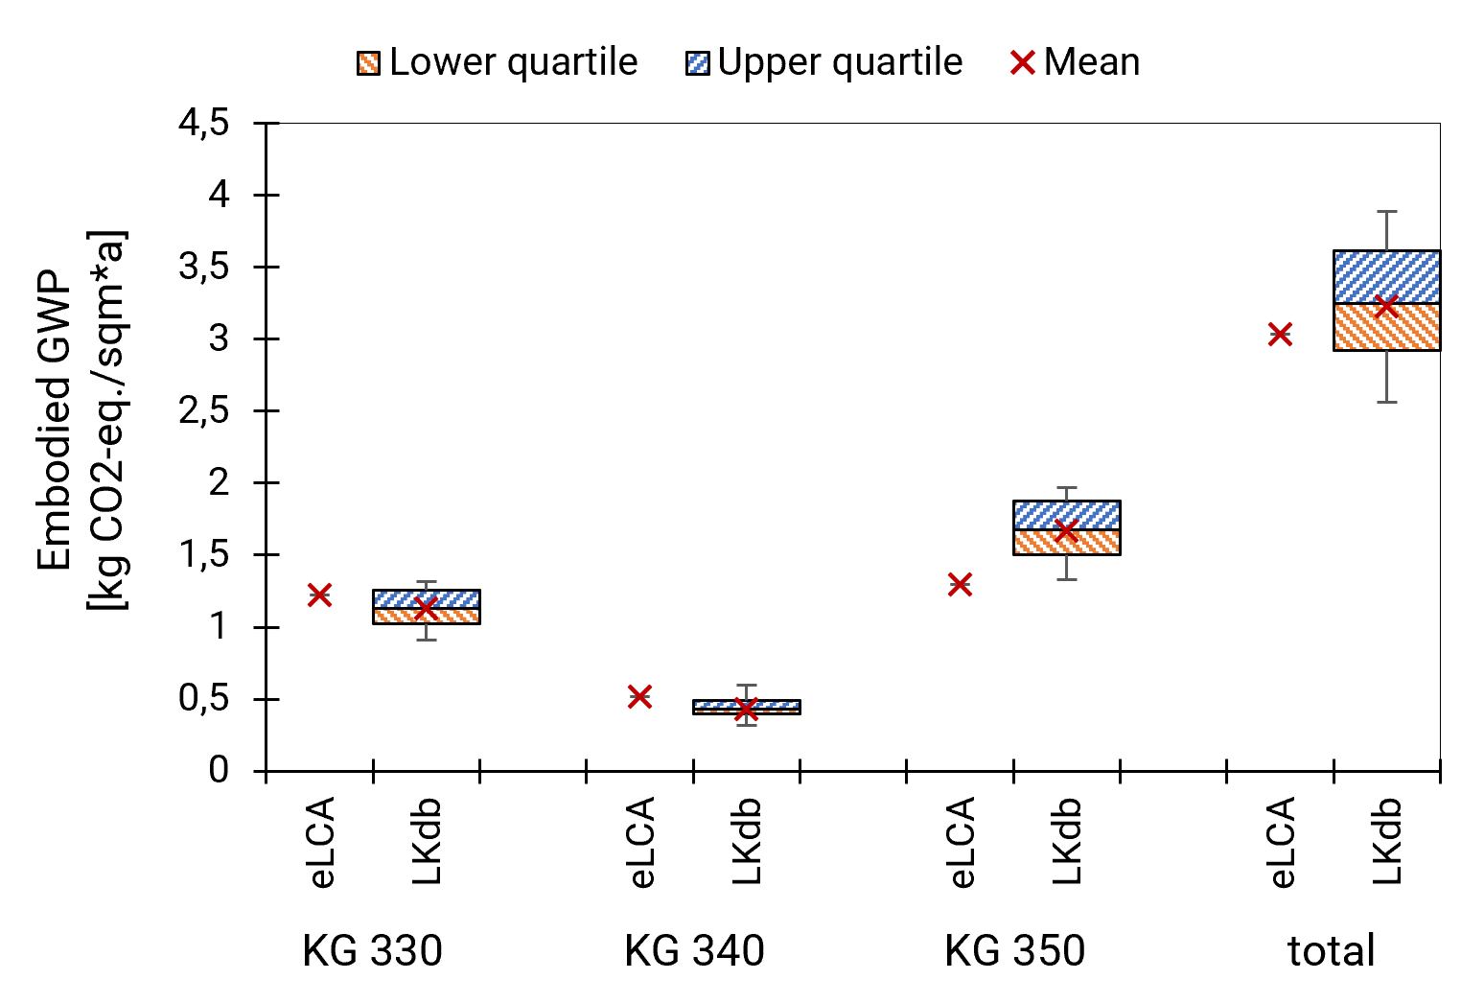
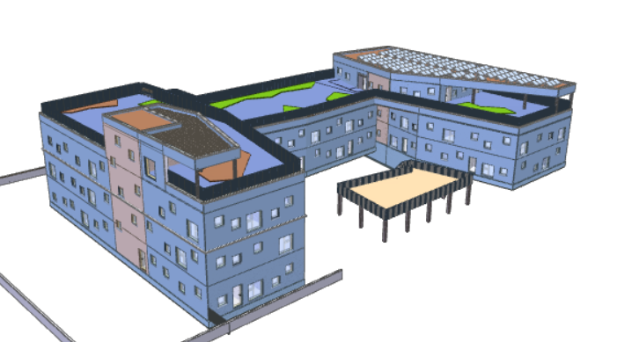
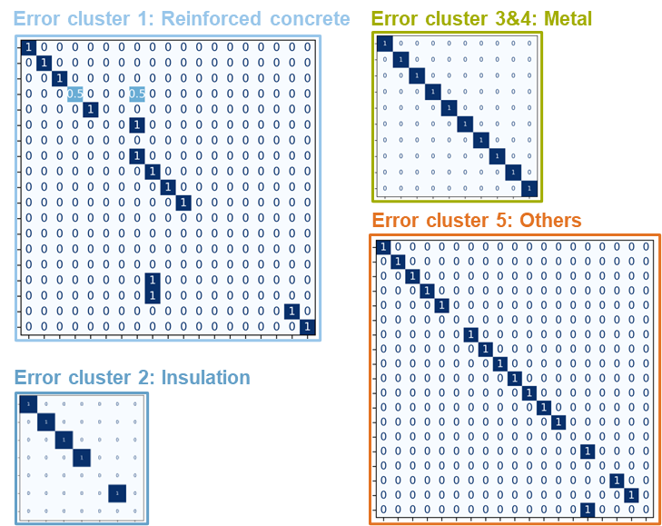
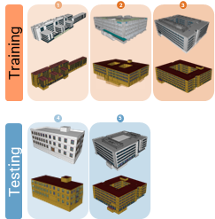
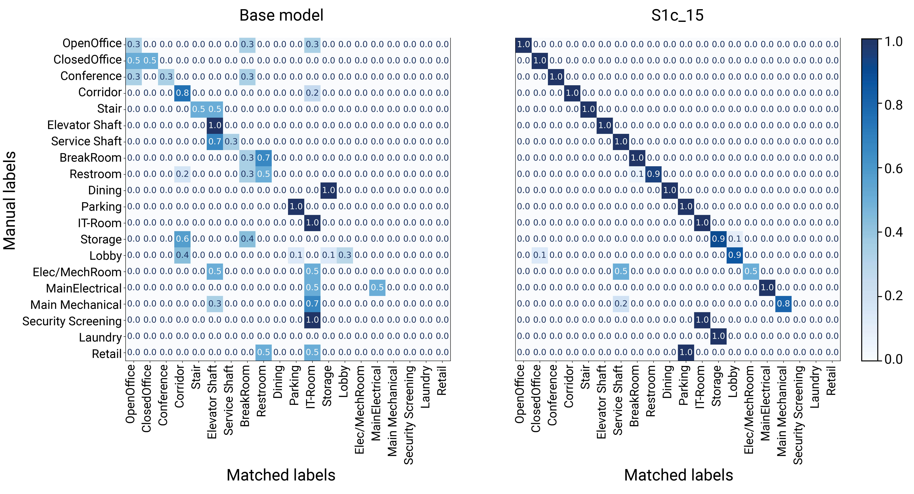
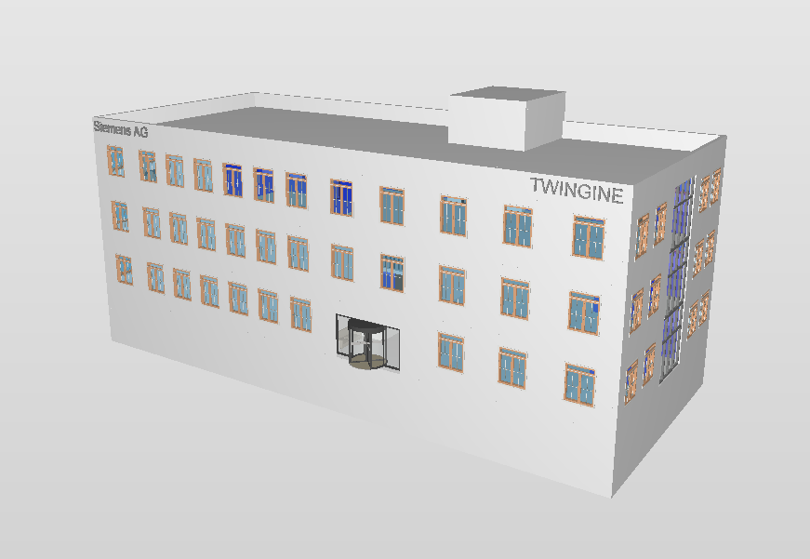
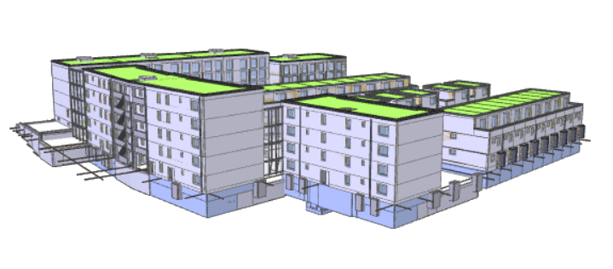
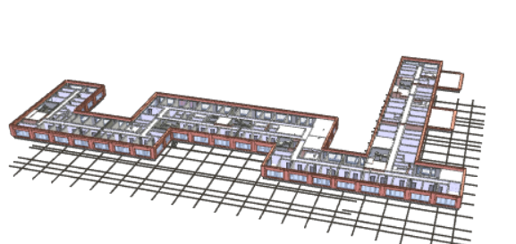
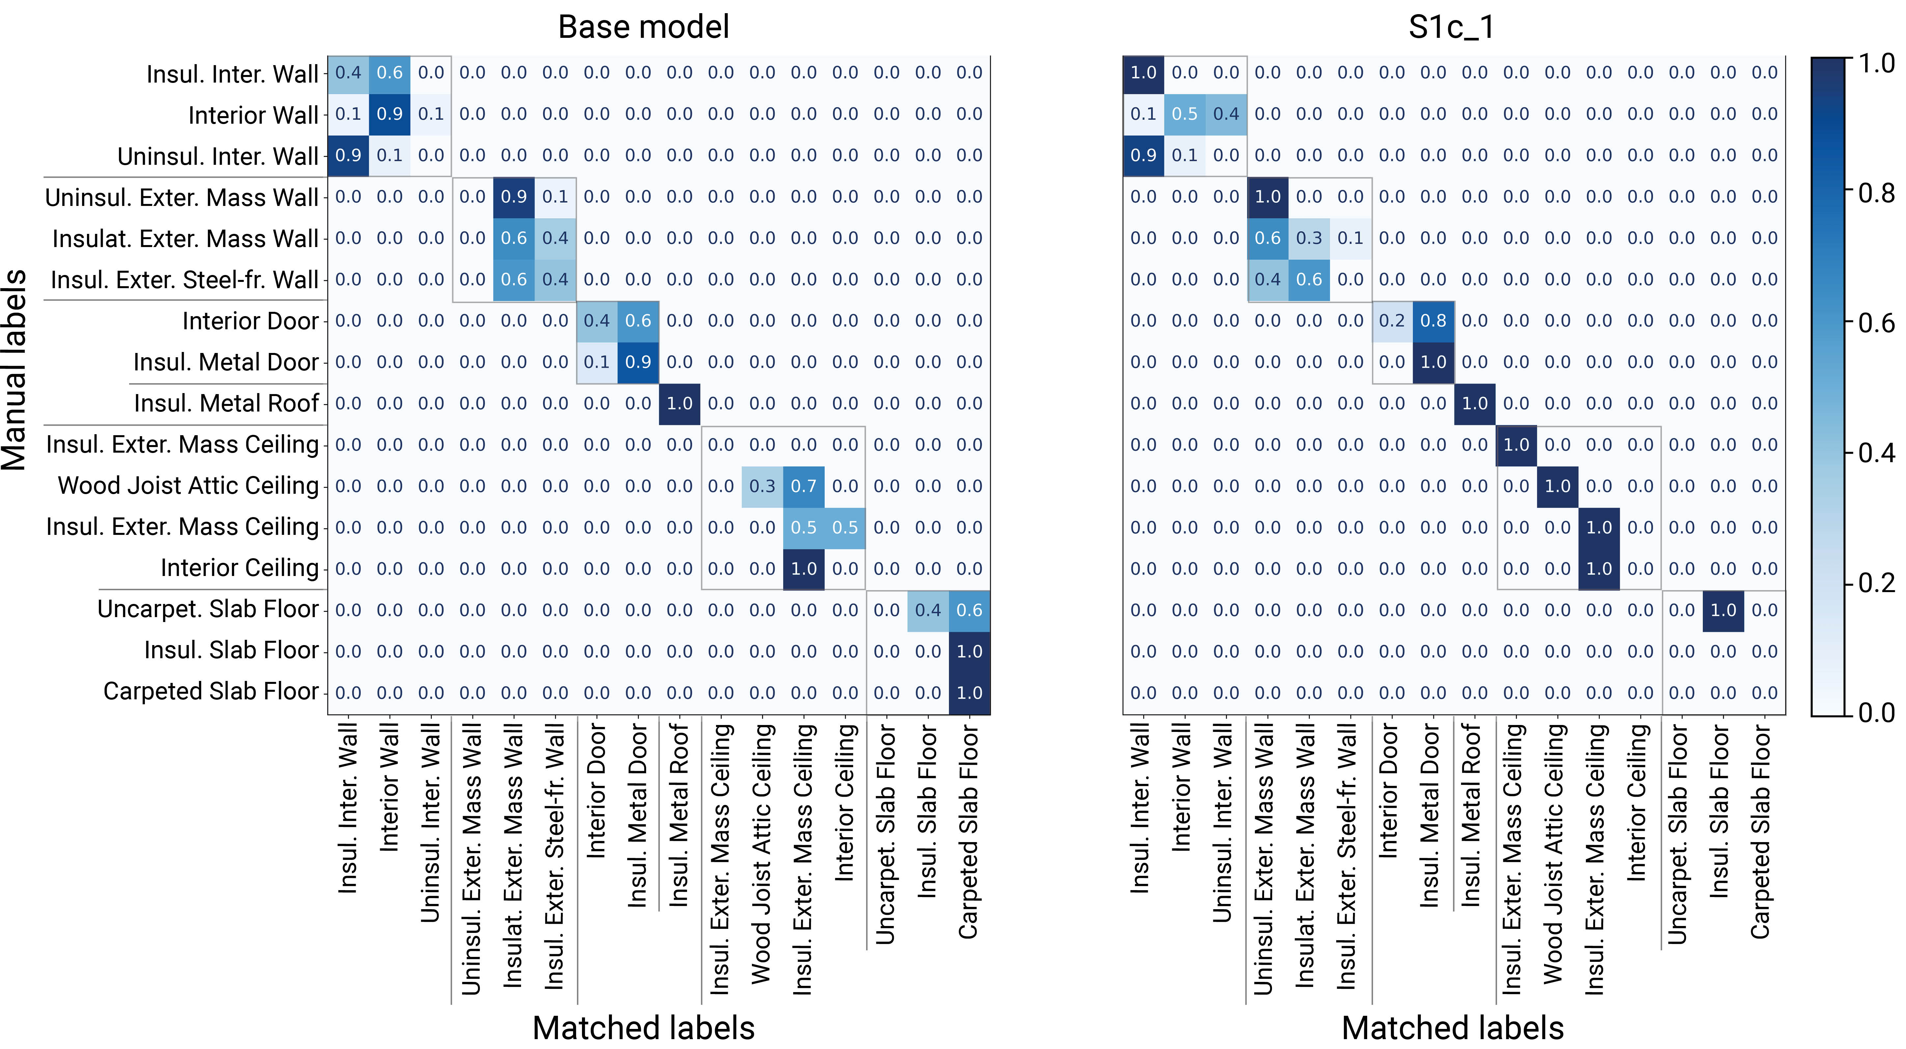
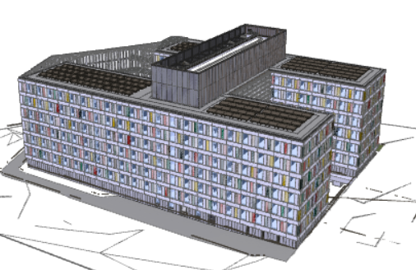
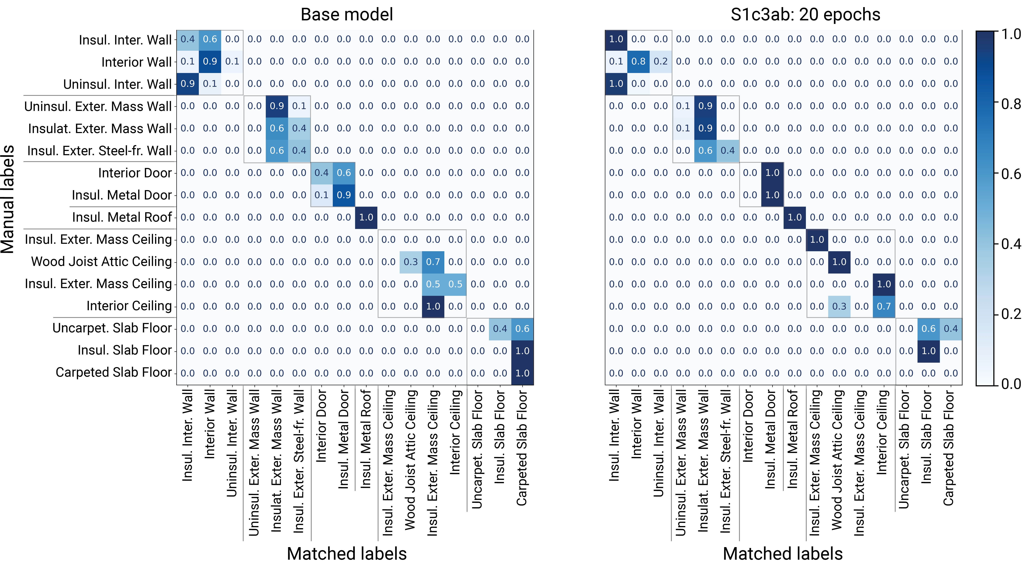
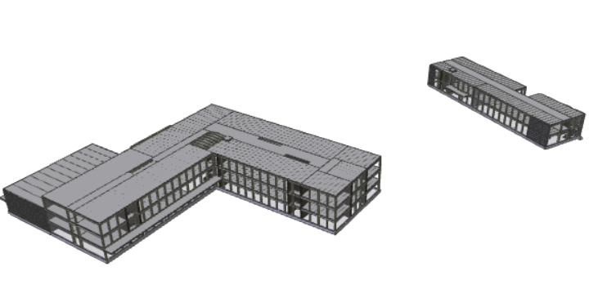
Research overview
PhD
BIM
LLM/ STS
LCA
MP
BEPS
BIM4EarlyLCA
New buildings

Slide 3
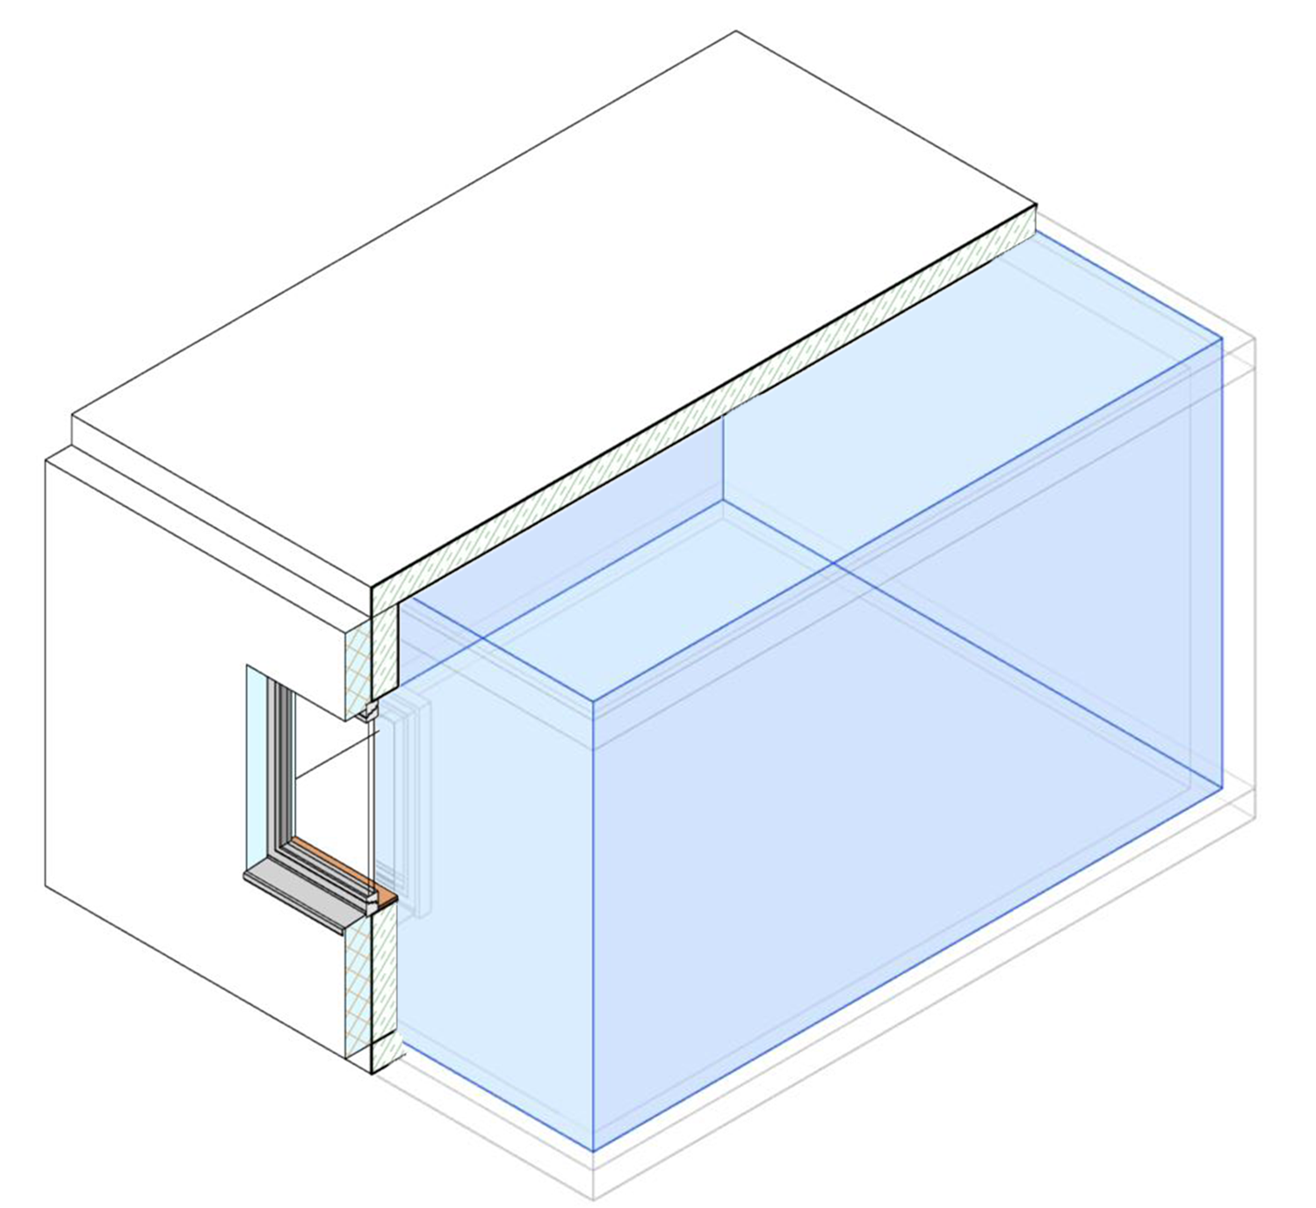
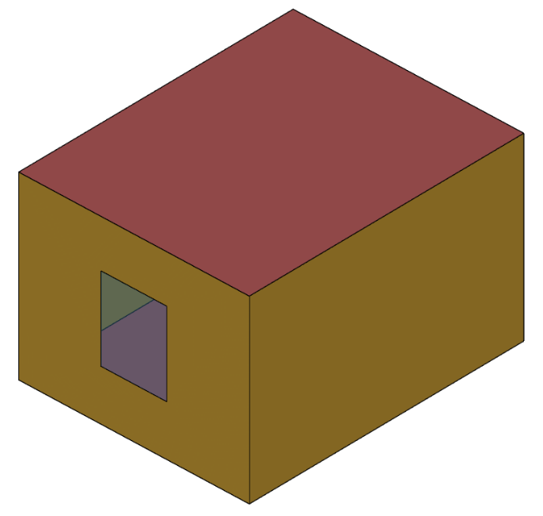
Problem: semantic enrichment of BIM
Life Cycle Assessment
Building Information Model
Building Energy Model
Layer 1:
Reinforcement steel (2%)
Concrete C20/25 (98%)
Layer 2:
Mineral wool (facade insulation)
Layer 3 (missing in BIM):
Interior lime plaster
Layer 4 (missing in BIM):
Application primer emulsion, dispersion paint
Wall name:
Exterior_CMU_Insulated
Materials:
Concrete
Rigid insulation
Insulated exterior mass wall:
Layer 1: Stucco
Layer 2: Concrete
Layer 3: Typical Insulation
Layer 4: Gypsum
LCA
datasets
Wall set
Storage:
Lighting
Electric equipment
Infiltration
Ventilation
Setpoint (Heating/ cooling)
Room:
Cleaning room
MEP space type

Slide 4
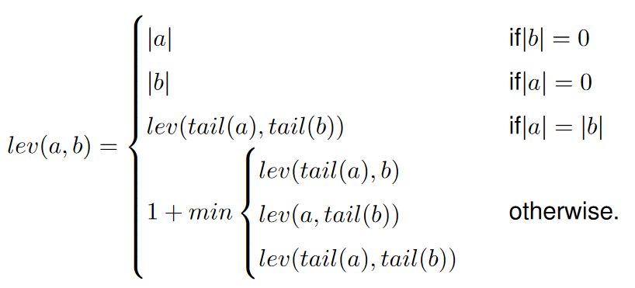
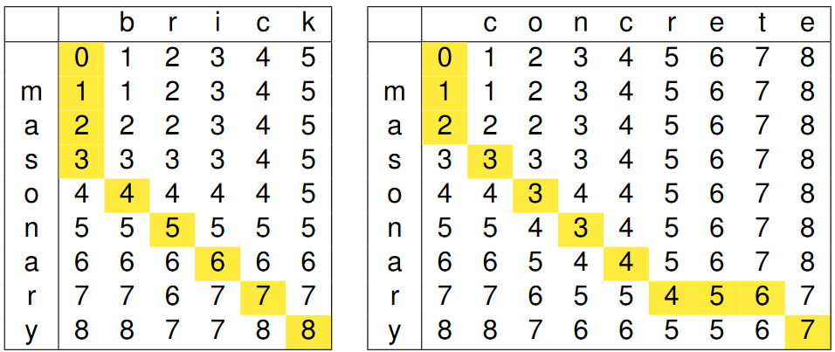
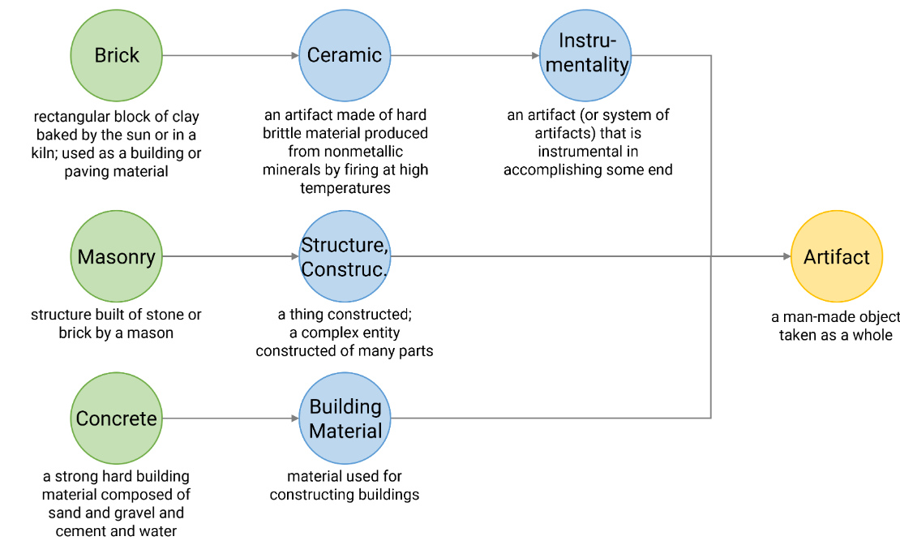
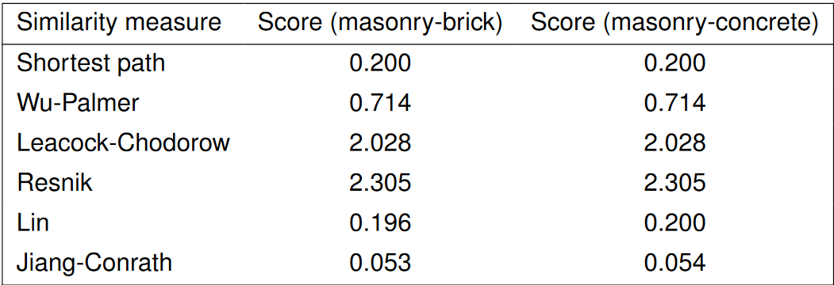
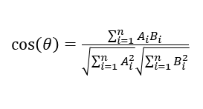
Semantic Textual Similarity (STS)
NLP model | Similarity measure
- | Levenshtein distance
Lexical-Semantic Nets | Synset similarity, e.g. Shortest path
Transformer-based Large Language Models (LLM) | Cosine similarity
$\cos\left(θ\right)=\frac{\sum_{i=1}^{n}{A_{i}B_{i}}}{\sqrt{\sum_{i=1}^{n}{A_{i}^{2}}}\sqrt{\sum_{i=1}^{n}{B_{i}^{2}}}}$

Slide 5
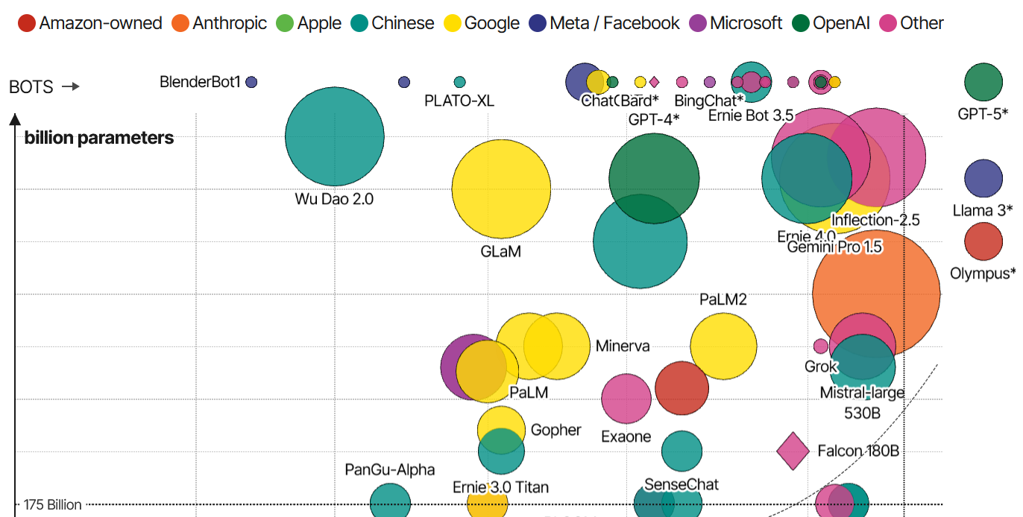
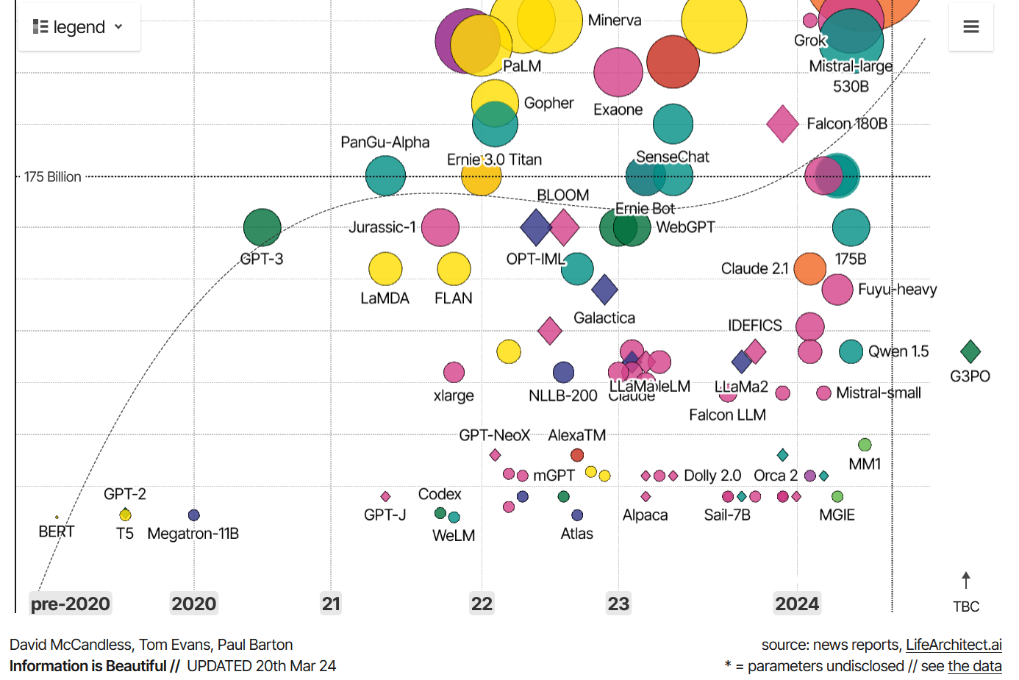
Rise of LLMs
ranked by capabilities, sized by billion parameters used for training

Slide 6
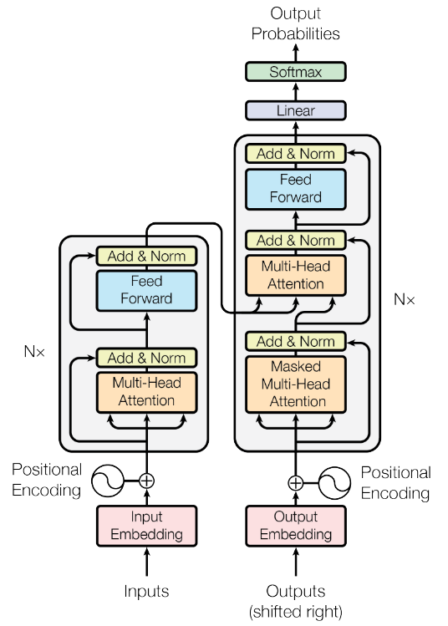
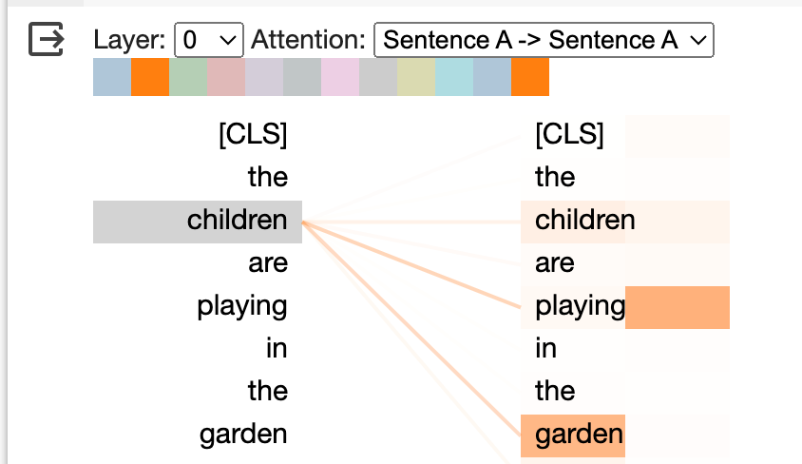
Transformers
Attention is all you need (Vaswani et al., 2017)
Encoder-Decoder Structure, but with attention replacing RNN
Recurrent layers are not needed anymore
Attention mechanisms to process sequences in parallel, rather than sequentially
Transformers require a large amount of computational power, especially for longer sequences
https://medium.com/@vimal.parakhiya/decoding-large-language-models-a-deep-dive-into-the-self-attention-mechanism-967d6207d4ae
(Vaswani et al., 2017)

Slide 7
Semantic Textual Similarity (STS)
Deep Learning
Transfer Learning: instead of training a model from scratch, use models pre-trained on a large dataset → fine-tuning with small dataset of specific task (reuse general-puprose LLM, avoid over-fit)
Natural Language Processing (NLP): convert text to numbers (vectors for distance, direction)
Word Embeddings: Word2Vec, BERT
Sentence Embeddings: Universal Sentence Embeddings
Semantic Textual Similarity (STS): contextual similarity by cosine similarity measure

Slide 8
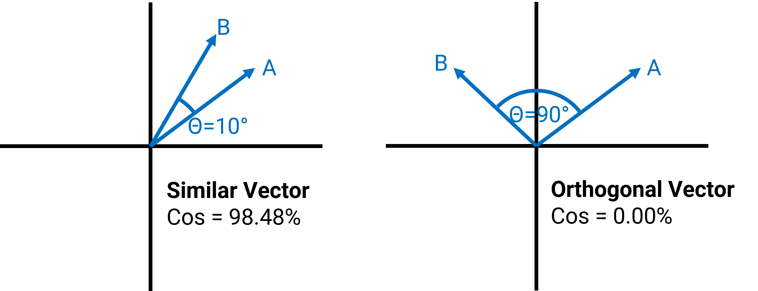
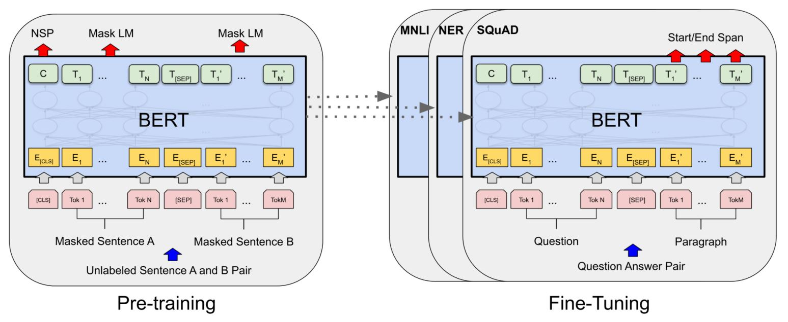
Semantic Textual Similarity (STS)
Language Model
Similarity measure
Example:
[ 7.93417156e-01 8.29650760e-02 -5.23231030e-02 -2.17395127e-01
-8.32237974e-02 -4.45498765e-01 -1.26688731e+00 1.06830096e+00
-1.28666349e-02 -4.68899488e-01 -2.02071592e-01 -1.12816297e-01
2.69040763e-02 -4.06338722e-02 -6.89153850e-01 3.63473892e-01
1.11588106e-01 3.40398014e-01 4.84653145e-01 -2.50174493e-01
-3.53295594e-01 1.23900771e-01 1.11937448e-01 -6.00896478e-02
-3.12148392e-01 5.75537622e-01 9.36730027e-01 -5.60345173e-01
5.78632295e-01 -2.32372671e-01 1.69208661e-01 4.12962675e-01
8.03140178e-02 7.45790243e-01 1.17071569e+00 5.55167198e-02
5.11050224e-01 1.16298109e-01 9.20241475e-02 -9.87720788e-02
8.48577380e-01 5.31948626e-01 9.33959424e-01 -1.32031858e-01
9.00211811e-01 -5.83819568e-01 8.29421043e-01 -3.51497233e-02
1.84658214e-01 1.58213913e-01 -8.74938011e-01 2.04985574e-01
2.12046504e-01 2.44288906e-01 4.61633772e-01 4.49981354e-02
2.33117819e-01 2.25253910e-01 -5.51613033e-01 2.82539278e-01
2.29331344e-01 -2.41953611e-01 -1.69738233e-01 -9.45715532e-02
-3.71751010e-01 8.33538234e-01 1.52621496e+00 -4.84886497e-01
-6.13606155e-01 -5.57552934e-01 2.55793810e-01 -6.92006886e-01
-4.54984093e+00 -9.26977396e-02 -9.40760851e-01 3.21871191e-02
-2.16004774e-01 9.72391486e-01 1.59482658e-01 5.63296318e-01
2.68730372e-02 7.18028486e-01 6.60112977e-01 3.96659315e-01
3.07498455e-01 8.34056139e-01 -9.23457742e-01 -2.11890787e-01
-2.71091163e-01 -3.53735745e-01 -6.20788261e-02 1.69884533e-01
-1.26969349e+00 -1.24605739e+00 1.20583892e+00 2.81507641e-01
5.37502527e-01 2.25627422e-02 -3.65057230e-01 -3.24838996e-01
-6.73068821e-01 -5.55100083e-01 1.07220717e-01 7.51177743e-02
1.66999847e-01 -5.65669760e-02 -5.37174821e-01 1.97182149e-01
-4.85657305e-01 -1.11633591e-01 2.20505241e-02 5.47537506e-01
2.90986821e-02 -2.91154683e-02 2.24938482e-01 -2.10108027e-01
3.73894393e-01 -7.86128998e-01 9.21761215e-01 1.62584692e-01
-1.37326717e-01 -5.73756874e-01 4.02603030e-01 -5.42482495e-01
6.53179139e-02 -2.96782076e-01 2.84805834e-01 7.83194184e-01
3.37617815e-01 -5.08406579e-01 5.62487006e-01 -4.30884808e-01
-1.25970215e-01 -3.65098596e-01 3.71568829e-01 4.17400122e-01
9.65109020e-02 -3.05784672e-01 2.10360259e-01 -1.59321725e-01
-2.36658186e-01 7.30582327e-03 -7.98410177e-02 8.79049838e-01
7.04189360e-01 6.05629325e-01 1.38470769e+00 -5.37037373e-01
-1.99557826e-01 6.51216283e-02 -6.25732541e-03 -5.78052342e-01
1.10243547e+00 2.29339153e-01 3.28719079e-01 -7.76662678e-02
-8.21682155e-01 -8.00741017e-02 -3.72380257e-01 2.23960578e-01
-4.26753163e-01 3.52671117e-01 1.93373784e-01 9.66680884e-01
-7.24408865e-01 -4.63018149e-01 -2.46008560e-01 -3.53394419e-01
-5.13954759e-01 1.58451557e-01 -7.71883726e-02 1.94275439e-01
-4.01165813e-01 -1.64506599e-01 3.39347392e-01 2.44310722e-01
3.79376084e-01 1.13751984e+00 1.40489742e-01 5.84856093e-01
-8.58848333e-01 -1.00996271e-02 3.53537858e-01 -9.77599502e-01
2.69020647e-01 3.32219511e-01 -6.85725510e-01 6.66895270e-01
-1.93581432e-01 -6.22250140e-03 7.48491883e-01 -6.89815581e-01
-7.87970424e-02 1.10012487e-01 -2.43320256e-01 -2.24682540e-02
-3.57071310e-02 -1.59448966e-01 5.26317358e-02 5.60355783e-01
8.92967582e-01 -1.61882773e-01 3.23787928e-01 -8.11748505e-02
-8.88107419e-02 -3.04983258e-01 8.74929354e-02 -1.05804515e+00
-2.95586050e-01 1.79473773e-01 5.42225957e-01 -6.63240433e-01
-3.77704948e-01 2.11305737e-01 3.03511024e-02 -3.40882301e-01
3.09231400e-01 8.73124719e-01 -2.78483182e-01 5.67523777e-01
-3.14469934e-01 -4.36114132e-01 -7.01730609e-01 -1.66682661e-01
-5.00753522e-01 -2.59878486e-01 -1.92758143e-02 -7.27440953e-01
-7.90189326e-01 3.34672332e-01 -3.10532808e-01 -4.10227001e-01
5.83508611e-01 1.43373716e+00 3.59099001e-01 5.18511117e-01
6.08694255e-01 -2.08158582e-01 7.45840013e-01 -1.58267528e-01
-4.90233451e-02 7.38504082e-02 5.05458534e-01 3.18468213e-01
7.10750073e-02 -4.66306508e-01 1.73503920e-01 5.65444469e-01
6.80207834e-02 3.12143624e-01 4.08284962e-02 -8.66480947e-01
4.83854711e-02 6.64438546e-01 -8.11929703e-02 -5.08115888e-01
4.66900468e-01 -3.58327448e-01 -9.11293775e-02 9.12261844e-01
-2.84069419e-01 -4.12509561e-01 -1.32767960e-01 7.05837160e-02
1.27318501e+00 -6.35570958e-02 -6.71987891e-01 5.19288778e-01
-3.96836579e-01 -2.83882141e-01 4.42507923e-01 9.11628380e-02
2.36631855e-02 -4.12411541e-01 -3.50247234e-01 6.25860691e-01
3.07056010e-02 1.00811219e+00 1.89153284e-01 4.58502144e-01
1.49567771e+00 -2.83000290e-01 -2.02027470e-01 5.46329260e-01
-1.27066851e-01 -3.11615288e-01 -6.11885190e-01 1.58946753e-01
3.57714370e-02 -3.01720500e-02 -4.15183067e-01 5.18441856e-01
-4.93103266e-01 5.47533706e-02 -4.99157667e-01 3.92679155e-01
-1.75812587e-01 -2.51360625e-01 -4.88607734e-02 3.43798280e-01
-1.34233758e-01 9.96006012e-01 -2.61857539e-01 7.27524757e-02
2.37225801e-01 -5.57635352e-02 -4.84738648e-01 -6.53715208e-02
-1.95787162e-01 4.16614771e-01 -1.98015228e-01 -1.57584861e-01
8.04035902e-01 -6.38814092e-01 8.33452865e-02 4.46270019e-01
3.97350967e-01 1.92115307e-01 9.43569243e-01 -9.21103477e-01
-6.03356600e-01 -4.32370842e-01 4.32011306e-01 -1.72371641e-01
6.53024673e-01 -3.05769652e-01 -4.81042981e-01 2.63146944e-02
3.85118186e-01 4.83796000e-01 -5.16638994e-01 -3.21957201e-01
-5.80514848e-01 1.19222388e-01 -1.10021257e+00 -3.26117605e-01
1.71316528e+00 5.62162735e-02 9.50355828e-03 6.64872944e-01
-5.39093077e-01 2.66112536e-01 1.79609895e-01 4.05989766e-01
-3.71596873e-01 -6.48266673e-01 -2.76225656e-02 3.37252110e-01
1.84154809e-02 4.36090529e-01 1.10443246e+00 1.36103049e-01
-9.86590028e-01 -1.37833089e-01 5.37889838e-01 -1.99922055e-01
-5.76203823e-01 3.32201868e-01 3.40699732e-01 -8.47409308e-01
-4.21136558e-01 -6.15115583e-01 2.01261625e-01 -3.87923419e-01
5.21669686e-01 -5.55739880e-01 -3.18780154e-01 -6.02304675e-02
-2.84414947e-01 -2.51529336e-01 -3.07689309e-01 4.87605631e-01
7.72765428e-02 3.99792373e-01 2.59738833e-01 1.45707622e-01
1.89506114e-01 2.95574725e-01 -1.22231627e+00 5.52306652e-01
-1.12291574e+00 6.41016960e-01 6.72316551e-02 -4.66993451e-02
1.90138876e-01 -9.00714278e-01 8.36803019e-03 -1.69438422e-02
-5.92977822e-01 -6.50723338e-01 -5.18072784e-01 1.56105012e-01
-3.59951437e-01 3.87876928e-02 -8.72222066e-01 -3.30499373e-03
8.93233716e-01 -1.20444655e-01 1.41373527e+00 -3.20495158e-01
7.75437474e-01 3.06213588e-01 -3.02815020e-01 -5.42093292e-02
1.22276336e-01 -6.05847120e-01 2.34447181e-01 3.80676538e-02
3.63660723e-01 2.21035540e-01 -7.63507128e-01 -9.39299107e-01
5.88006198e-01 -3.65265012e-01 1.60602391e-01 -3.06411594e-01
-6.28080249e-01 7.12894261e-01 -5.28892338e-01 -9.97515917e-01
8.36685374e-02 -4.27438676e-01 -6.54080749e-01 5.63178062e-01
-2.52053589e-02 -6.11614466e-01 -5.46239853e-01 -3.43902320e-01
-4.79859889e-01 -4.56492364e-01 -7.58665726e-02 6.47508204e-01
-1.06110370e+00 -2.09942795e-02 -7.83309102e-01 -2.37874240e-02
-3.91762376e-01 -5.91796756e-01 -3.93111929e-02 -3.35438877e-01
1.40335038e-02 -4.24379915e-01 6.47341013e-02 8.78049508e-02
1.37439162e-01 -1.96740180e-01 -7.84101486e-01 -4.66014415e-01
5.06868064e-02 2.47897916e-02 -4.98707086e-01 3.76915455e-01
1.24918312e-01 -1.69203132e-01 4.12189662e-01 -8.61794233e-01
-6.78871155e-01 -1.11508757e-01 -6.78885579e-01 2.59941131e-01
-1.46831349e-02 -2.56075114e-02 3.66047621e-01 -8.52454782e-01
2.12828606e-01 -7.41954446e-01 -1.23513341e-01 -7.37691343e-01
6.09610200e-01 -8.40500236e-01 4.47567165e-01 -4.35227931e-01
4.99380231e-01 7.13433385e-01 -6.05246425e-01 -1.13739826e-01
4.65037405e-01 1.89203620e-01 5.82755953e-02 4.61967811e-02
-3.23371917e-01 -1.92195207e-01 1.97781801e-01 -3.69411409e-01
-1.06980197e-01 2.59817421e-01 8.00486058e-02 9.51058418e-03
3.02866101e-01 1.88881904e-03 1.15565985e-01 -1.40413582e-01
8.92238140e-01 -1.18600452e+00 5.56488872e-01 7.37461686e-01
9.39744592e-01 3.86909008e-01 1.57811141e+00 3.81787807e-01
-2.15259790e-01 -7.78924108e-01 1.16847619e-01 -1.19649720e+00
-8.46069038e-01 -5.40075421e-01 -7.51968145e-01 1.23884773e+00
-4.84374344e-01 -6.97239697e-01 -4.12126154e-01 -1.16760693e-01
-3.24822247e-01 1.90009072e-01 -3.34495574e-01 2.92782366e-01
4.63660121e-01 5.77235341e-01 -1.68476567e-01 8.80004644e-01
3.10535312e-01 -1.05125956e-01 1.21627942e-01 4.72453117e-01
1.39813340e+00 5.55745602e-01 3.66614878e-01 3.77451122e-01
-3.90589476e-01 -4.43344414e-01 -6.02789998e-01 7.83340216e-01
8.27827305e-02 1.44587800e-01 2.04348385e-01 -2.54174918e-01
2.80319154e-01 8.53757441e-01 -6.89254403e-02 -2.49775499e-01
-9.49245930e-01 2.89742827e-01 5.22765100e-01 2.25976050e-01
-9.63110328e-01 -4.47067112e-01 -4.46701676e-01 -1.42508850e-01
-1.29194602e-01 -1.12778580e+00 -2.39949301e-01 2.50462331e-02
-7.76521623e-01 1.81496888e-02 7.68089175e-01 -3.12704369e-02
-4.93964851e-01 9.01968718e-01 -2.61514187e-01 6.01293892e-03
-2.94394314e-01 -6.03471816e-01 -5.70318997e-01 -4.58910167e-02
-5.05368710e-01 9.27282274e-01 1.05101094e-02 -3.04134578e-01
-1.41699597e-01 5.59040785e-01 1.53377652e-03 -3.78428251e-02
-4.17304873e-01 4.28673744e-01 -2.60846496e-01 -4.54545438e-01
-4.14908350e-01 4.70070571e-01 -5.01714945e-01 2.51757562e-01
-1.88131362e-01 -2.60722250e-01 -1.85079545e-01 -2.83006579e-01
3.55063051e-01 1.88687950e-01 -8.42502594e-01 -6.71386957e-01
1.24344110e+00 -2.46767998e-02 -6.47865593e-01 1.01868495e-01
-1.48657620e-01 6.63356408e-02 7.70462975e-02 -2.96890616e-01
-6.68320179e-01 3.53565782e-01 5.94213083e-02 -7.08389342e-01
3.07263434e-01 4.04187113e-01 1.10012245e+00 -7.99584091e-02
-9.39760685e-01 4.89687771e-01 -5.42291999e-01 -7.43937433e-01
1.57381043e-01 3.34519073e-02 -3.97372961e-01 -8.70960429e-02
-1.20021963e+00 -9.80041862e-01 -3.47414285e-01 -6.70193434e-01
1.38850540e-01 6.26738787e-01 4.29225773e-01 5.00610650e-01
-2.91431785e-01 1.08529115e+00 4.86341119e-01 -2.52187014e-01
-3.61164868e-01 5.63975692e-01 1.41157135e-01 -5.64380735e-02
8.57155442e-01 -4.35316533e-01 7.73539543e-02 -3.33524793e-02
8.60679150e-02 5.15364647e-01 3.54378492e-01 1.09625168e+01
4.19652104e-01 1.19410813e+00 -8.43115568e-01 -1.81533322e-01
4.92928088e-01 -1.42919272e-01 1.52804360e-01 -4.36707288e-01
-2.41291970e-02 -3.60829234e-01 -4.16250885e-01 6.52575612e-01
-8.27805340e-01 -8.27721059e-01 -2.69816041e-01 -5.15553713e-01
3.88892502e-01 -3.03525746e-01 5.23445964e-01 -6.59306645e-01
-5.03555417e-01 4.56714451e-01 3.88177127e-01 5.02301991e-01
1.01066113e+00 -5.39673530e-02 -2.26399422e-01 -4.51337963e-01
-2.81162769e-01 -1.15852880e+00 -3.74303401e-01 1.13456559e+00
-6.05286777e-01 2.11646184e-01 -3.95028025e-01 3.94750237e-01
2.98588276e-01 -1.04184580e+00 4.94031578e-01 -1.53053850e-01
-3.74180079e-01 1.00309312e+00 8.22239935e-01 -2.31395155e-01
5.29232621e-01 -3.96025091e-01 1.35788068e-01 -1.15176804e-01
3.20620686e-02 -6.45730555e-01 -5.29725969e-01 5.13912916e-01
-5.16817510e-01 -5.84204316e-01 -3.03734615e-02 -7.02928722e-01
-7.01311648e-01 -2.59553432e-01 3.74039024e-01 1.82371736e-01
5.33550903e-02 -7.89539933e-01 -1.93450242e-01 3.00196499e-01
-9.13644195e-01 8.05464506e-01 8.33888412e-01 6.43017292e-01
-1.76989049e-01 -3.66481453e-01 -4.23485458e-01 -5.85697770e-01
4.27237213e-01 3.03330213e-01 -2.25601673e-01 -1.41714349e-01
3.20419848e-01 -3.73093754e-01 2.70743966e-01 -4.29871142e-01
-1.92693651e-01 -3.91600192e-01 -6.85277104e-01 -1.01155281e+00
-1.54100060e-02 1.55142963e-01 -1.38860986e-01 -4.33848023e-01
3.54915053e-01 5.12295485e-01 1.02278478e-01 9.56505477e-01
6.49094462e-01 7.99110711e-01 3.65924001e-01 7.89373875e-01
3.48500758e-01 -6.93622351e-01 -6.47317886e-01 5.44491589e-01
1.88926220e-01 3.92342985e-01 -4.26074505e-01 -8.83782983e-01
4.26133156e-01 3.77885550e-01 7.76099443e-01 -1.82269767e-01
-1.06373107e+00 3.57803315e-01 8.71052384e-01 -7.35188782e-01
-1.76440746e-01 5.35256207e-01 -6.52544260e-01 3.21372926e-01
8.19673091e-02 4.44514379e-02 -1.04063594e+00 2.81850398e-01
1.18795180e+00 3.33518744e-01 -2.34514147e-01 2.65670180e-01
3.22413921e-01 -2.02874511e-01 -1.20547223e+00 1.38298035e+00
3.21854532e-01 -5.60756803e-01 -1.48127985e+00 -1.08538294e+00]]
Transformer-based Large Language Models (LLM)
Cosine similarity
model = SentenceTransformer('bert-base-uncased‘)
cosine(concrete, cement) = 94,72 %
cosine(concrete, brick) = 83,33 %
Devlin, J., Chang, M.-W., Lee, K., & Toutanova, K. (2018). BERT: Pre-training of Deep Bidirectional Transformers for Language Understanding. https://arxiv.org/pdf/1810.04805
Vector embeddings of BERT with 768 dimensions

Slide 9
Semantic matching using LLM/ STS
Filtering
Similarity calculation
Legend:
Nodes:
Workflows:
1
Example IfcElement – Exterior walls
Classification
Filter
IFC Model
IfcProduct
Data from external DB
CMU_Insulated
Reinforced concrete wall
Database
2
CMU
Reinforced
concrete
wall
Tokeniz.
Selection & enrichment
Tokeniz.
STS
Vectoriz.
Vectoriz.
Vectoriz.
Vectoriz.
Similar. anal. & matching
61.49%
66.68%
66.53%
51.55%
Similarity of tokens
Similarity of terms
General
Save maximum similarities
66.68%
Comparison
3
Tokenization: splitting the text into discrete units, i.e., singular words
Vectorization: converting the textual terms/ tokens into a vector representation/ embeddings
Iteration
Select & enrich of data with highest cosine similarity to item

Slide 10
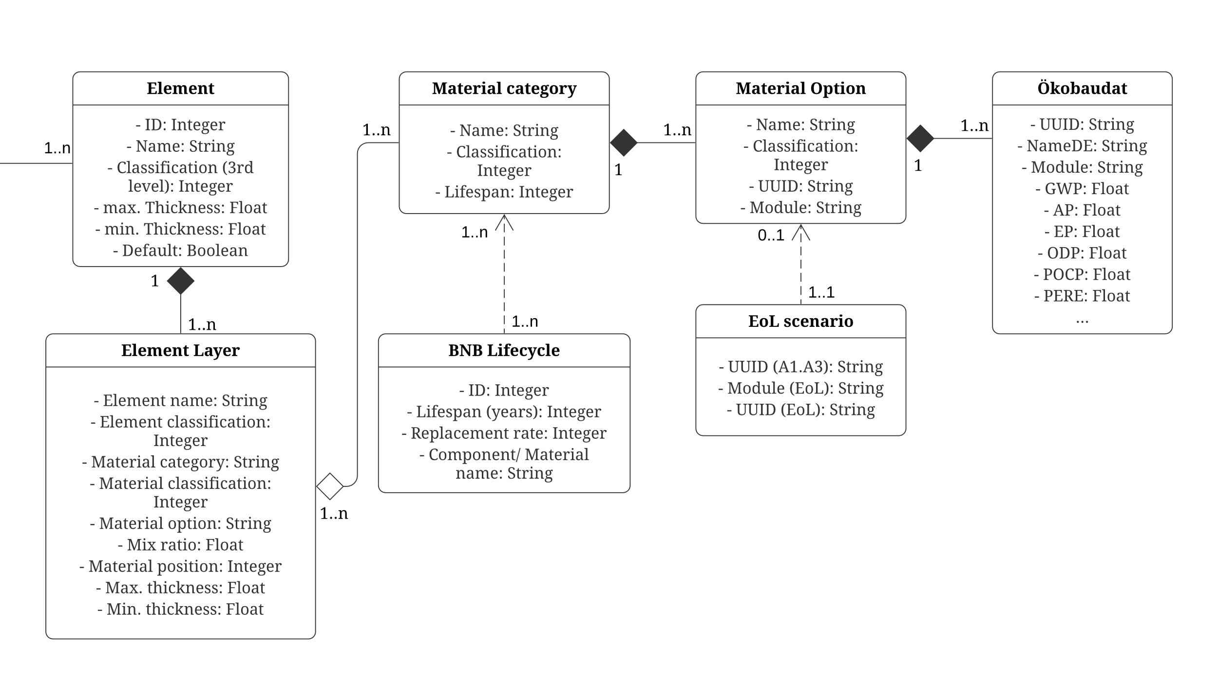
LCA knowledge database
Forth, K.; Abualdenien, J.; Borrmann, A. (2023): Calculation of embodied GHG emissions in early building design stages using BIM and NLP-based semantic model healing. Energy and Buildings 284

Slide 11
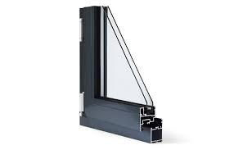
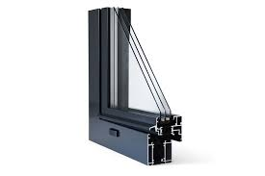
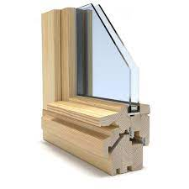
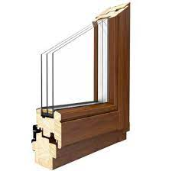
LCA result range of window variants
Forth, K.; Abualdenien, J.; Borrmann, A. (2023): Calculation of embodied GHG emissions in early building design stages using BIM and NLP-based semantic model healing. Energy and Buildings 284

Slide 12
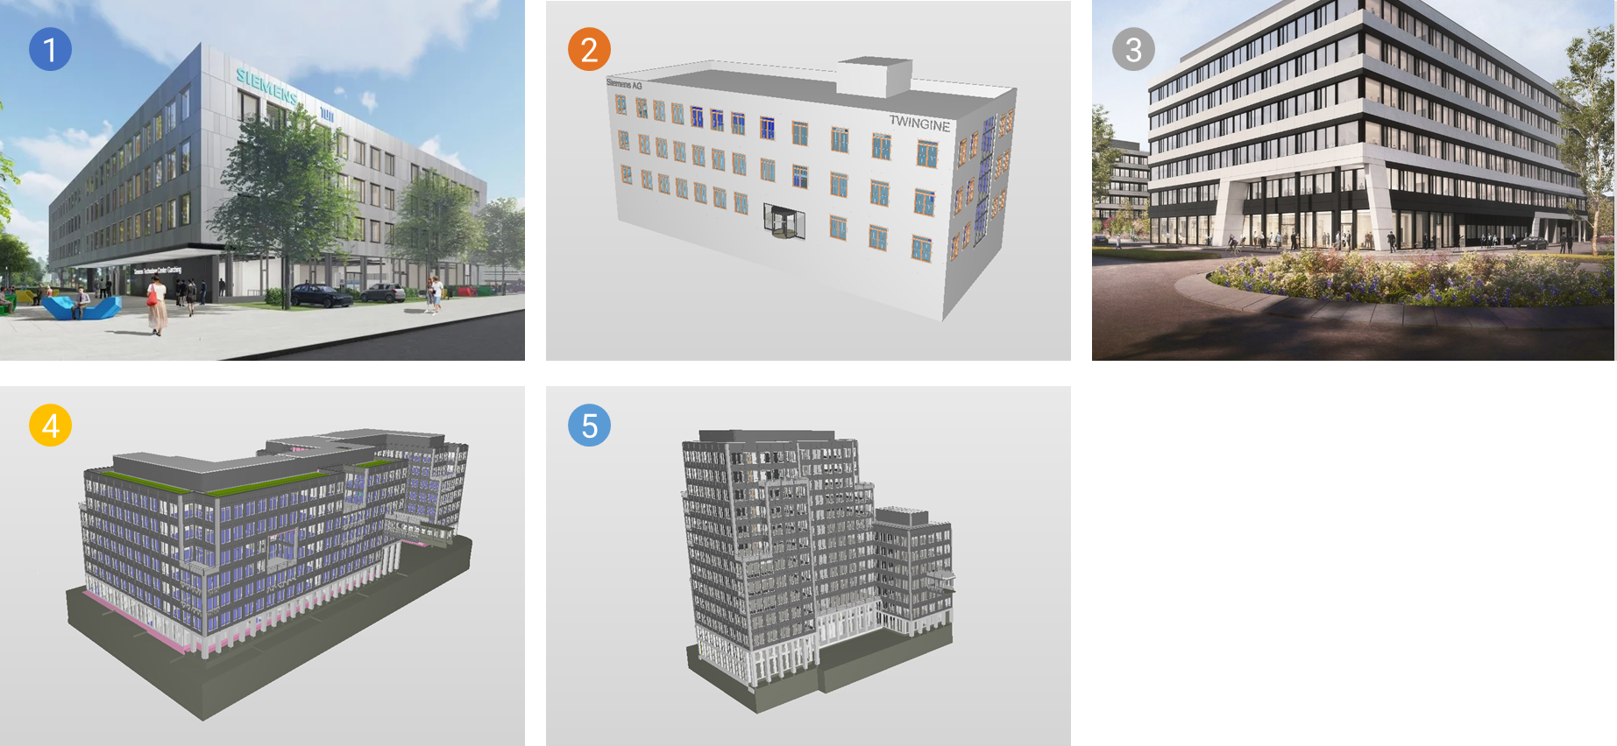
LLM-based semantic matching for LCA
Real-world case studies
Element matching performance:
Forth, K.; Abualdenien, J.; Borrmann, A. (2023): Calculation of embodied GHG emissions in early building design stages using BIM and NLP-based semantic model healing. Energy and Buildings 284

Slide 13

LLM-based semantic matching for LCA
LCA result ranges (GWP):
2.
2
Forth, K.; Abualdenien, J.; Borrmann, A. (2023): Calculation of embodied GHG emissions in early building design stages using BIM and NLP-based semantic model healing. Energy and Buildings 284

Slide 14






LLM-based semantic matching for MP
Strategies for fine-tuning & improving matching performance
1.
Adding domain-specific abbreviations
BIM abbreviations
AEC abbreviations
Combination of AEC- & BIM abbreviations
Applying different loss functions for fine-tuning , such as
CosineSimilarityLoss: positive (0.8), negative (0.3)
Contrastive Loss: positive (1), negative (0)
Multiple Negative Ranking Loss (MNRL)
Adding different/ multiple labels for further context information (Element name, classification, IfcType, etc.) using Softmax Loss Function
Adding negative/ contradicting word pairs
Filtering word pairs according to IfcTypeObject
IfcMaterial Match. Mat. Label
CMU concrete masonry unit
MEP Mech., Engin., Plumb.
2.
Masonry Brick 1/ 0.8
Masonry Brick 1
EW_CMU_Insul Brick 2
331 Brick 3
IfcWall Brick 4
3.
4.
Masonry Concrete 0/ 0.3
5:
IfcWall, IfcSlab, IfcWindow…
Forth, K.; Berggold, P.; Borrmann, A. (2024): Domain-specific fine-tuning of LLM for material matching of BIM elements and Material Passports. i3CE 2024, Carnegie Mellon University, Pittsburgh, USA, 2024

Slide 15
LLM-based semantic matching for MP
Forth, K.; Berggold, P.; Borrmann, A. (2024): Domain-specific fine-tuning of LLM for material matching of BIM elements and Material Passports. i3CE 2024, Carnegie Mellon University, Pittsburgh, USA, 2024

Slide 16
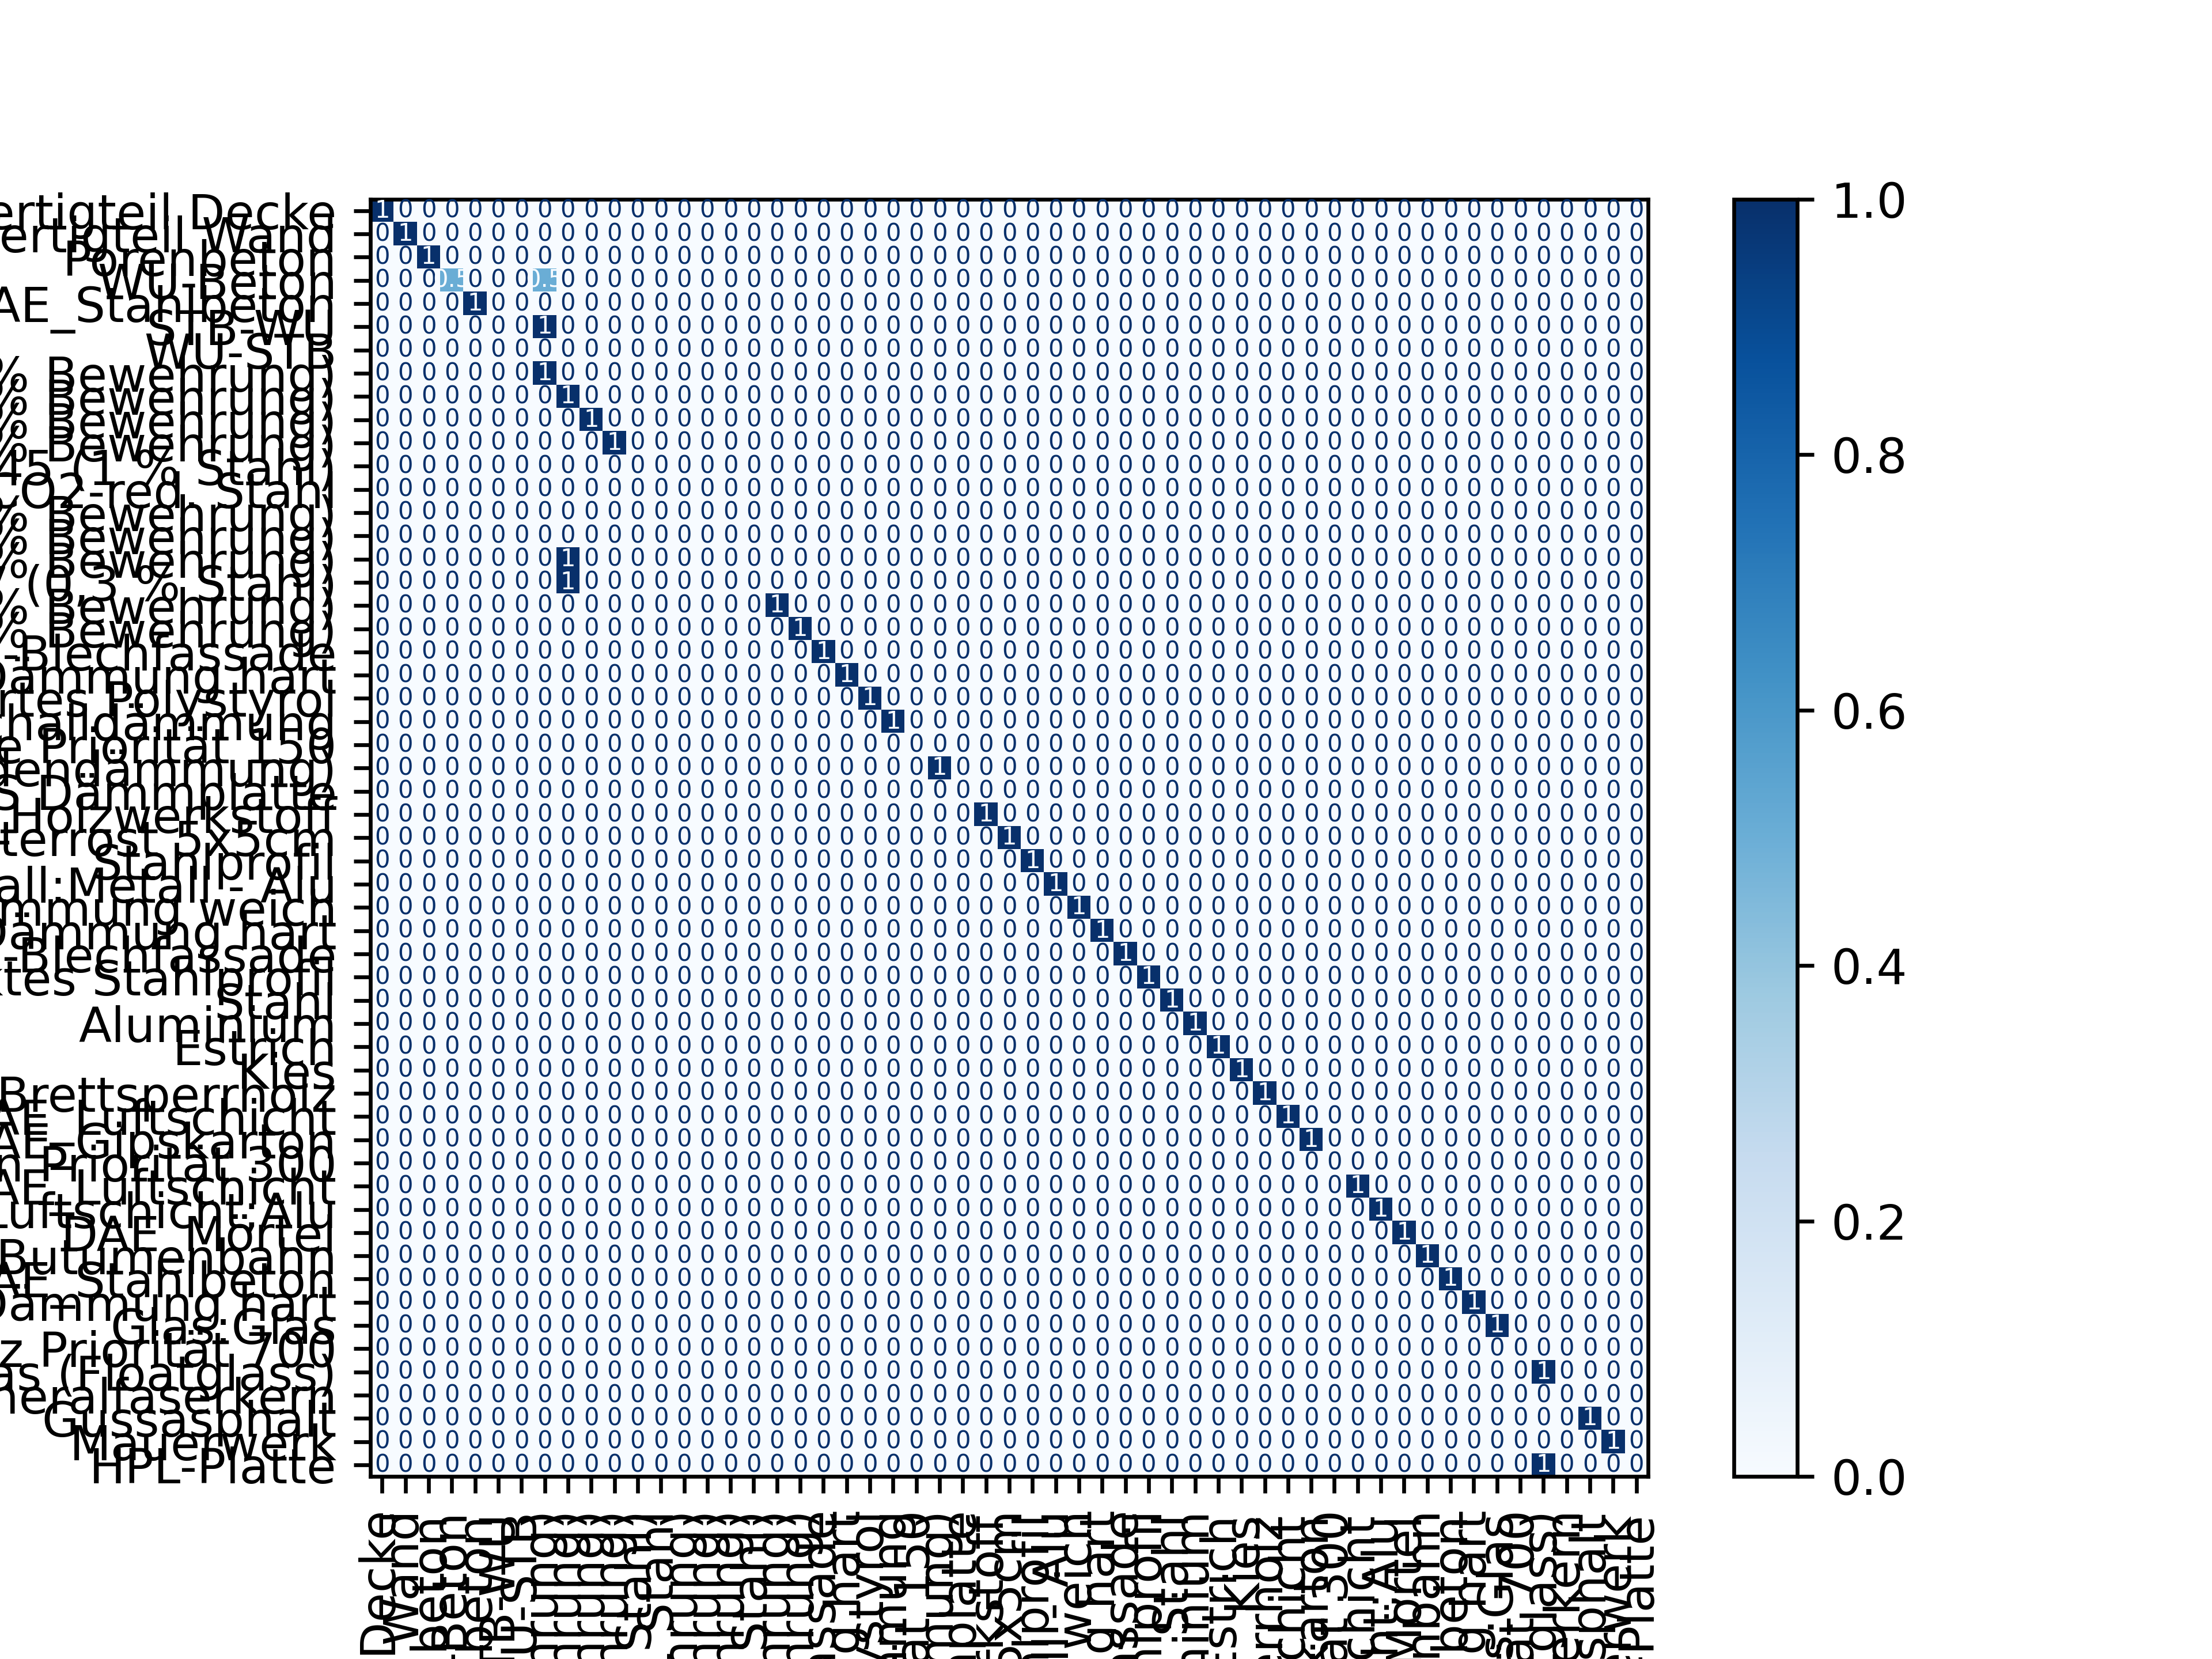
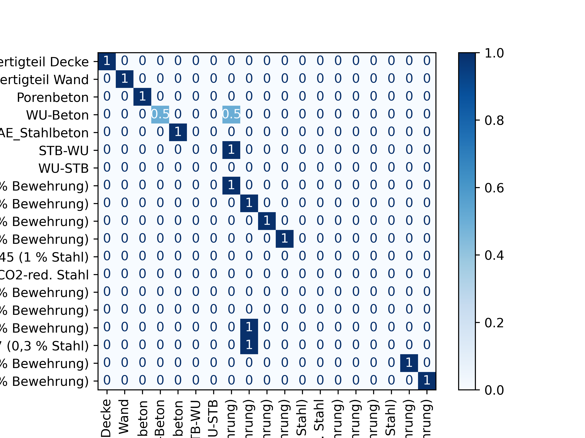
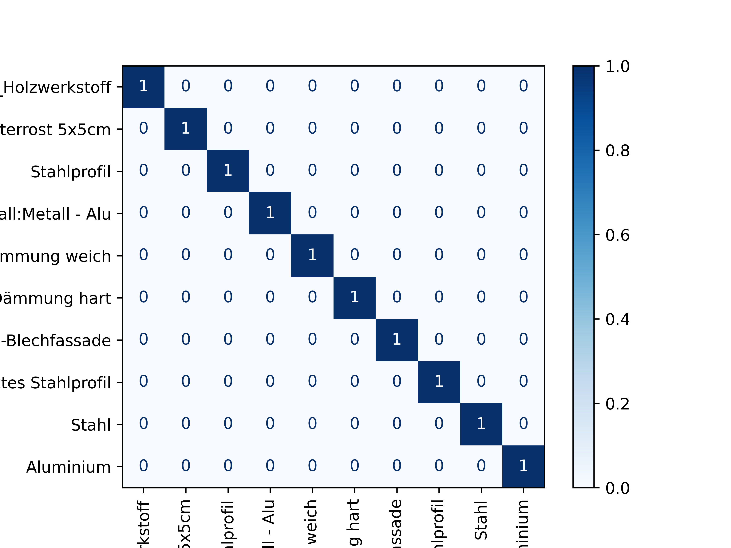
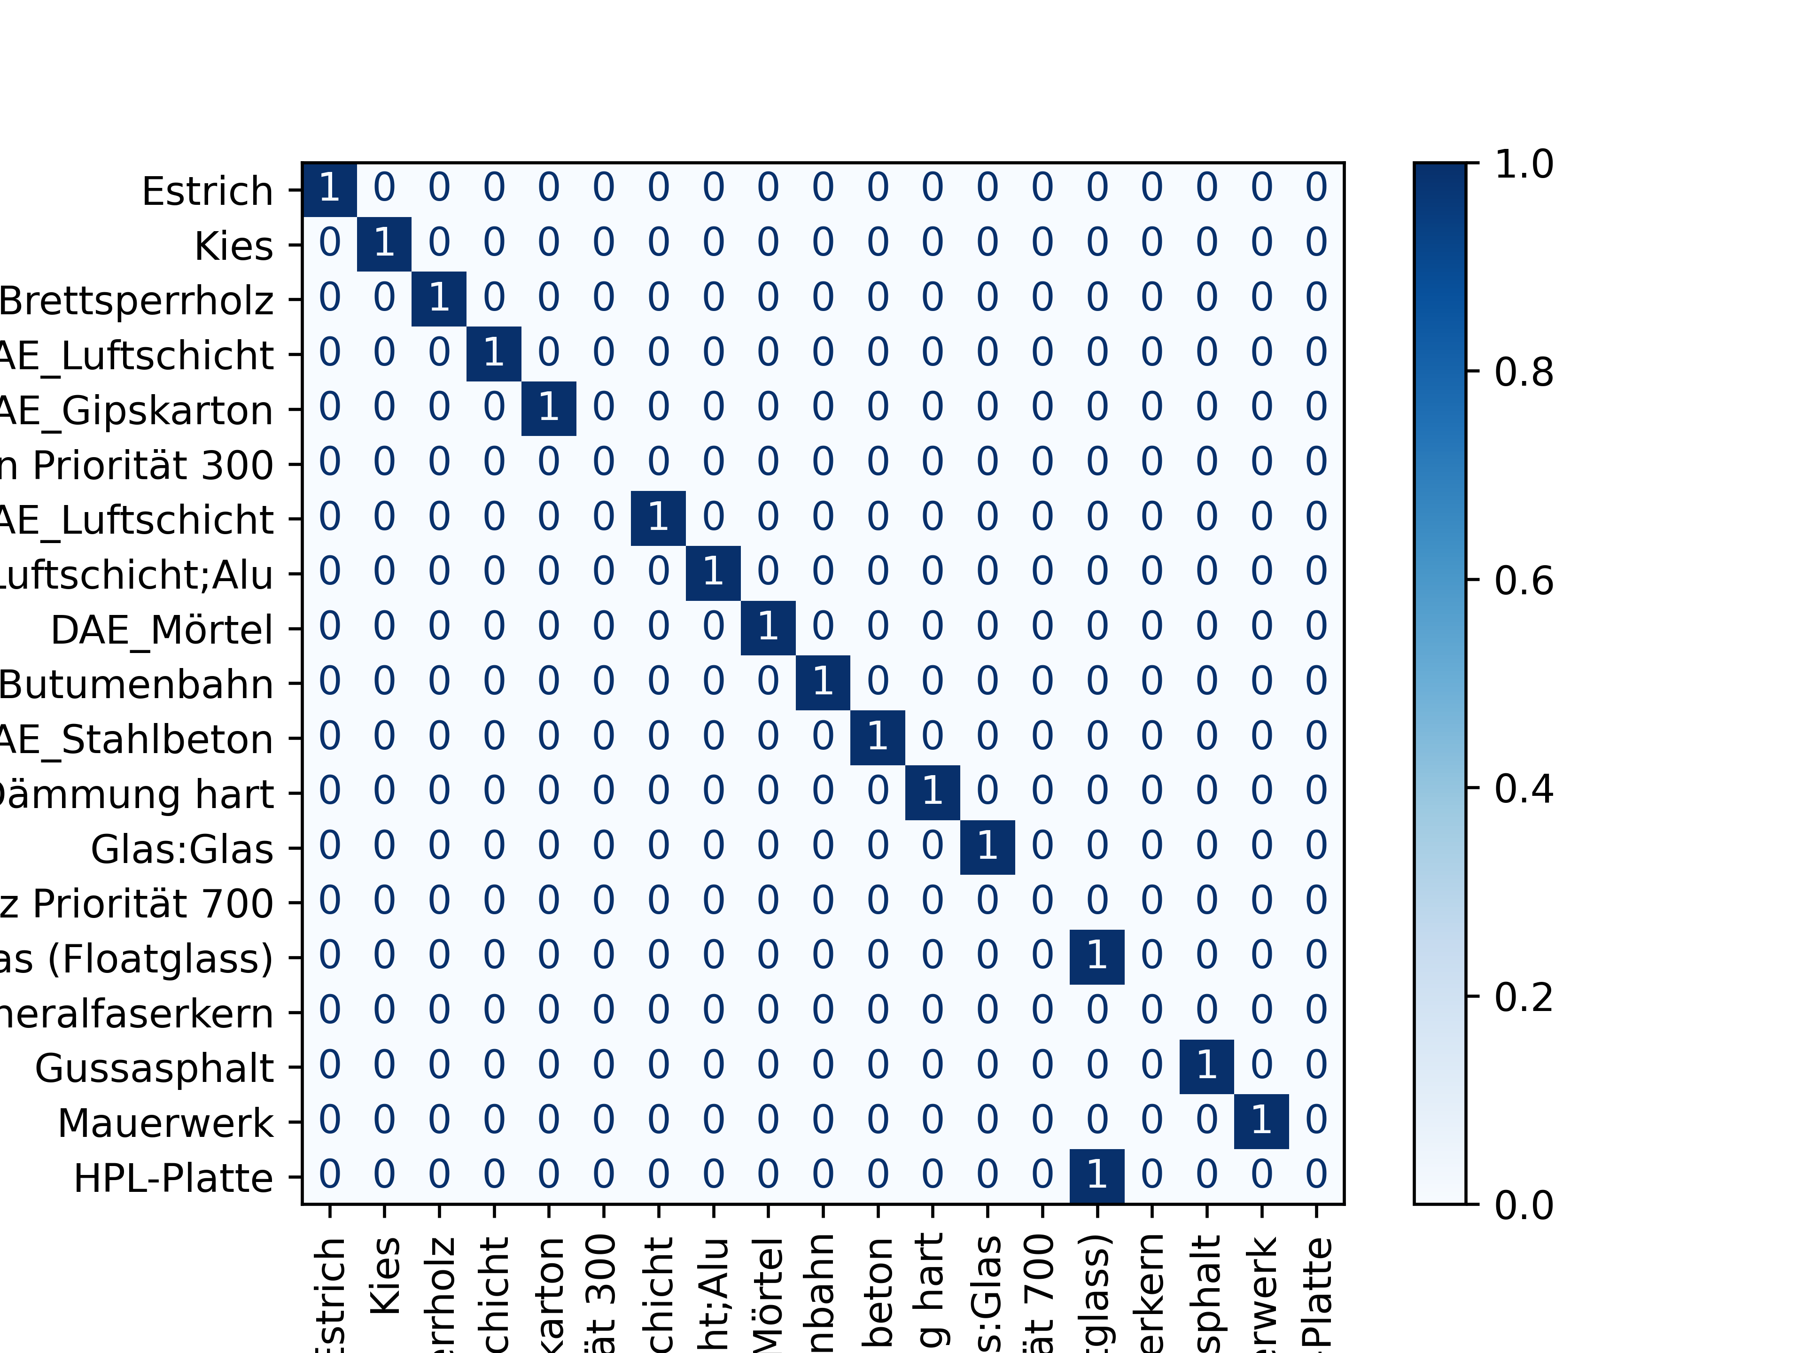
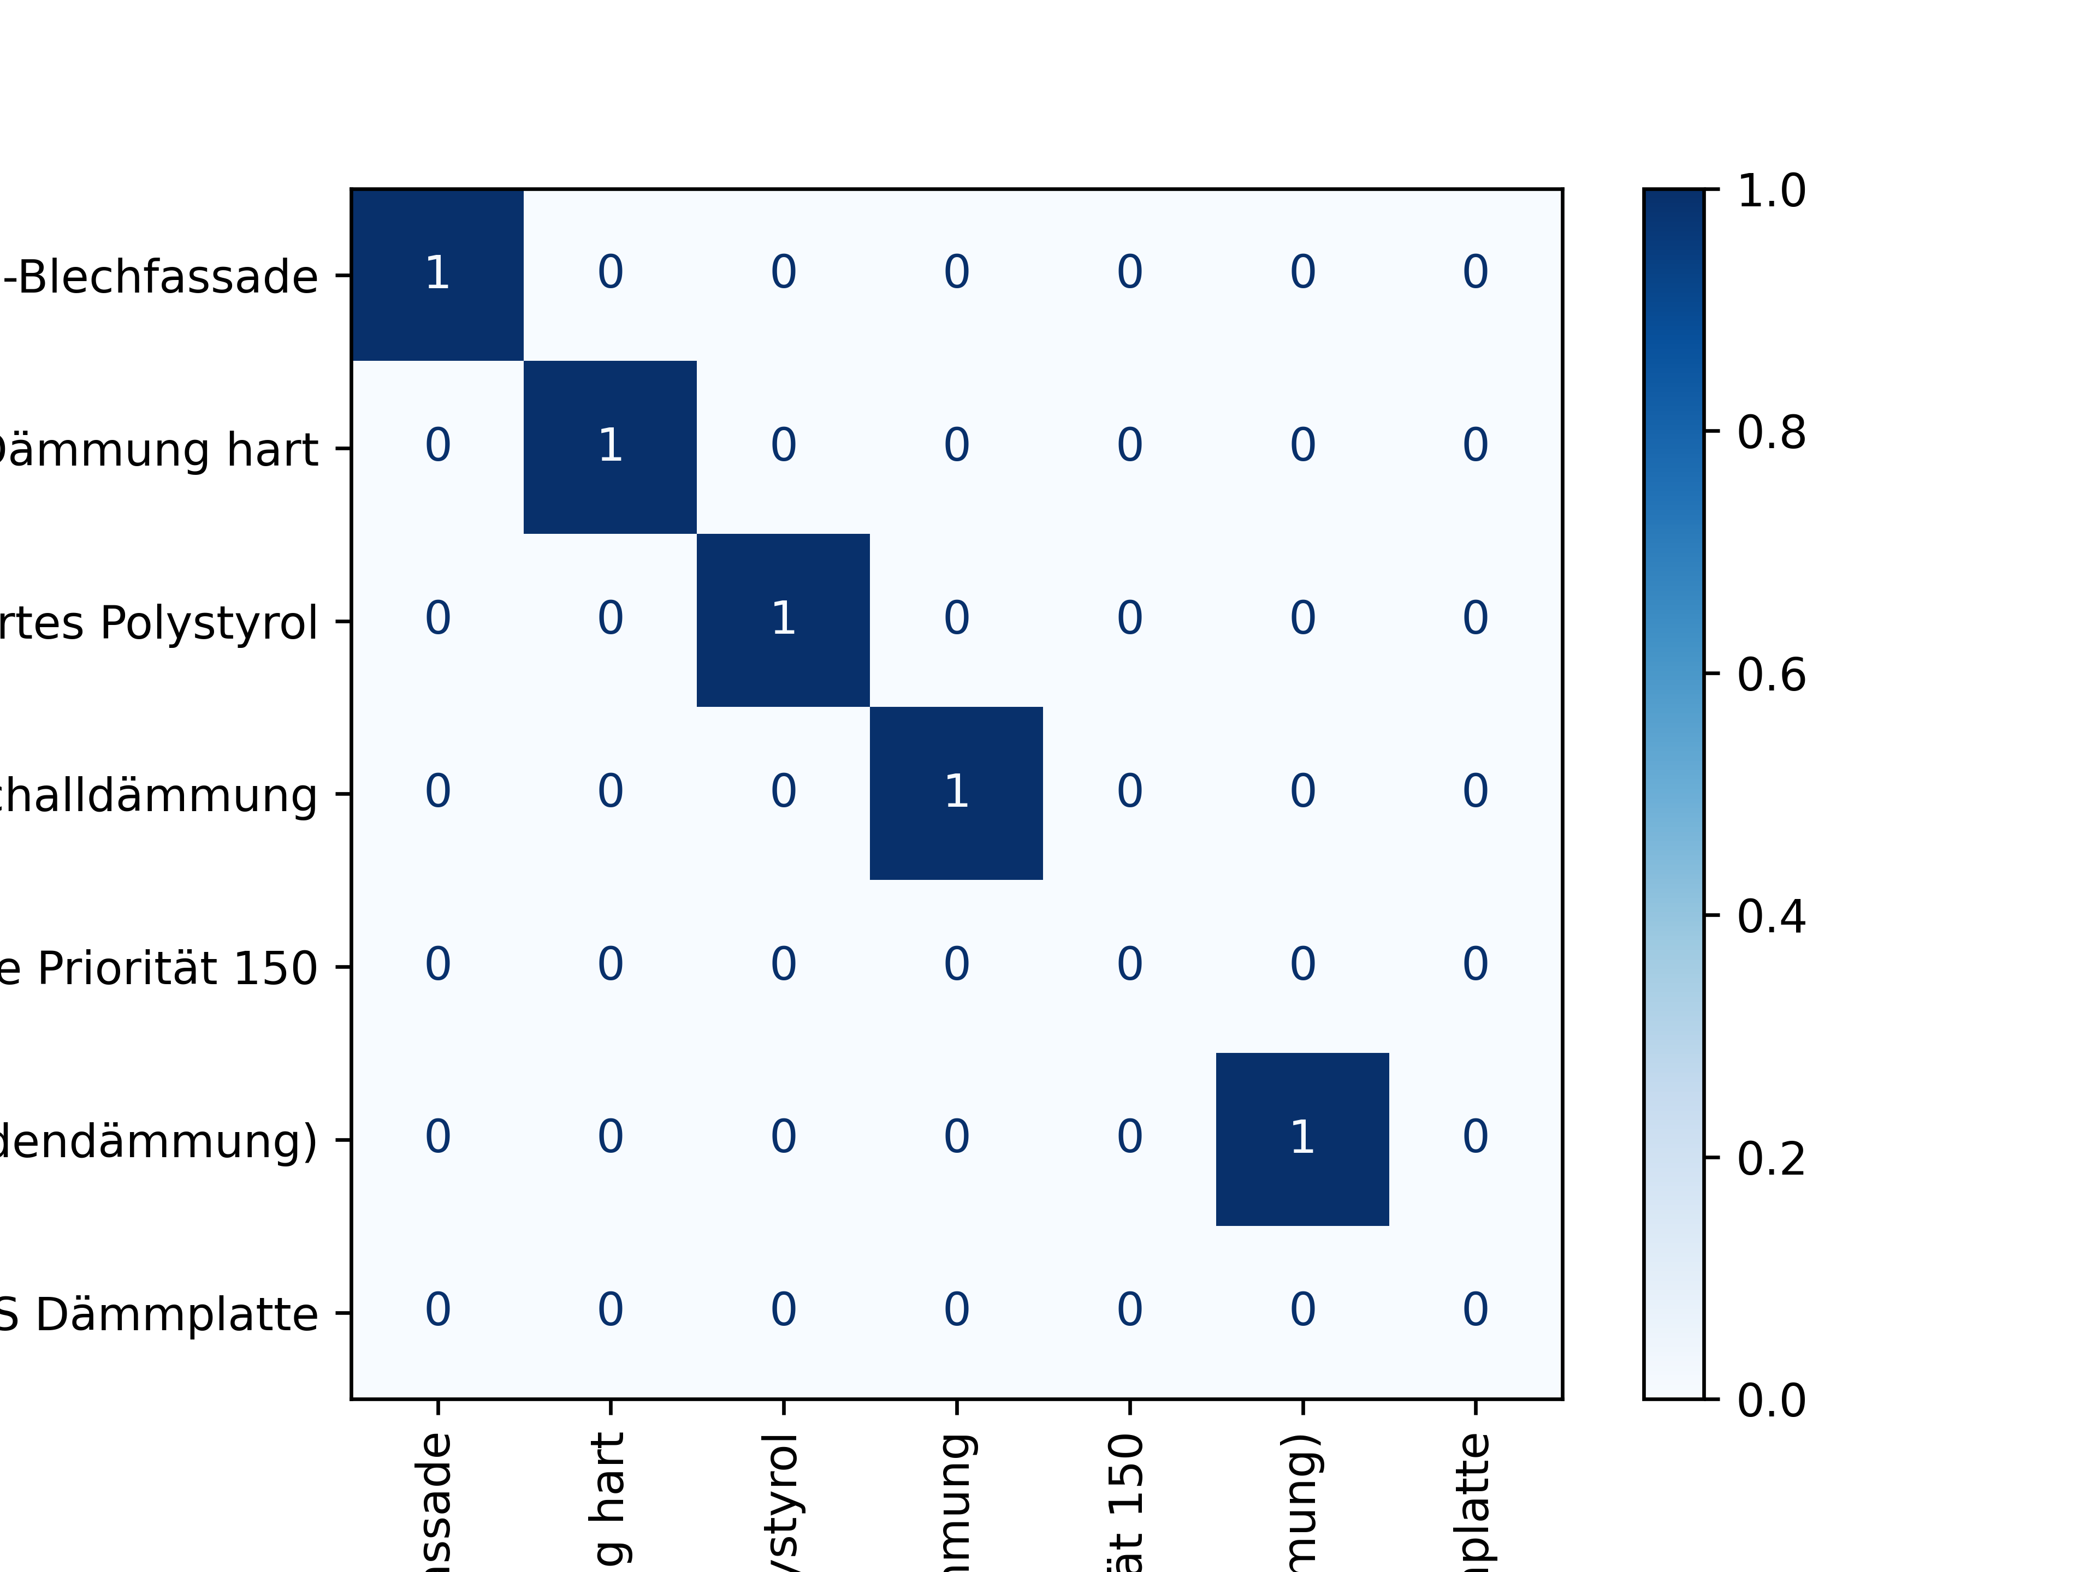
LLM-based semantic matching for MP
Confusion matrix of the best performing LLM
Error cluster 1: Reinforced concrete
Error cluster 3&4: Metal
Error cluster 5: Others
Error cluster 2: Insulation
Forth, K.; Berggold, P.; Borrmann, A. (2024): Domain-specific fine-tuning of LLM for material matching of BIM elements and Material Passports. i3CE 2024, Carnegie Mellon University, Pittsburgh, USA, 2024

Slide 17

LLM-based semantic matching for BEPS
Strategies for fine-tuning & improving matching performance
Monolingual fine-tuning:
Applying different loss functions for monolingual fine-tuning, such as
Cosine Loss
Contrastive Loss
MultipleNegativesRrankingLoss (MNRL)
Adding negative/ contradicting word pairs (already included in MNRL)
Adding abbreviations including
general ones in the AEC industry and
about construction and material nomenclature usually given in German BIM practice
Adding context, such as IfcTypes, isExternal, classifications using Softmax Loss Function and multiple labels
Multilingual fine-tuning:
using different multilingual student LLM, such as
LaBSE
XLM-RoBERTa and
Distilluse-v2
Adding more multilingual pairs of domain-specific materials translations
1.
I:
2.
II:
3.
4.
Forth, K.; Borrmann, A. (2024): Semantic enrichment for BIM-based Building Energy Performance Simulations using Semantic Textual Similarity and fine-tuning multilingual LLM. Journal of Building Engineering 95

Slide 18
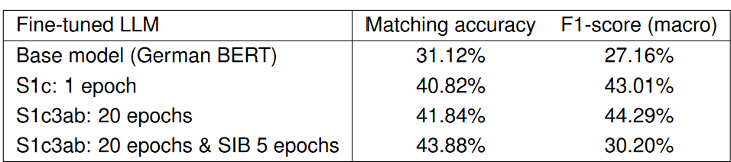
LLM-based semantic matching for BEPS
Room-specific matching of program types:
Element-specific matching of construction sets:
Forth, K.; Borrmann, A. (2024): Semantic enrichment for BIM-based Building Energy Performance Simulations using Semantic Textual Similarity and fine-tuning multilingual LLM. Journal of Building Engineering 95

Slide 19
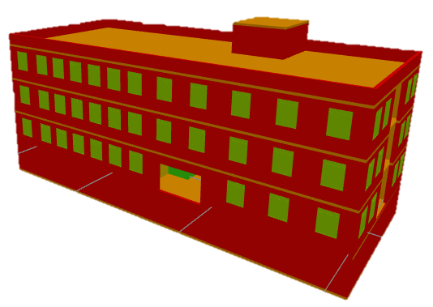
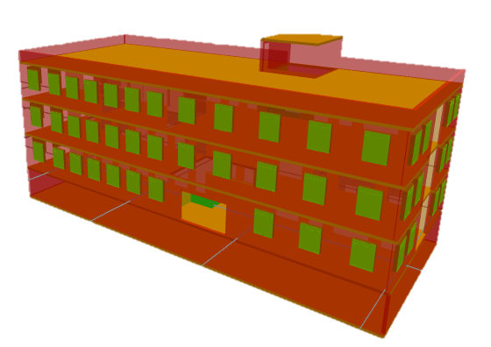
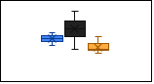
BIM4EarlyLCA: design decision support
LCA visualization strategies
BIM-based 3D color code
Heat map
Bar charts diagrams
Element 1
Element 2
Element n
Uncertainty visualization strategies
Transparency of 3D elements
Gradient color ranges
Boxplot diagrams
Element 1
Element 2
Element n
Forth, K.; Hollberg, A.; Borrmann, A. (2023): BIM4EarlyLCA: An interactive visualization approach for early design support based on uncertain LCA results using open BIM. Developments in the Built Environment 16

Slide 20
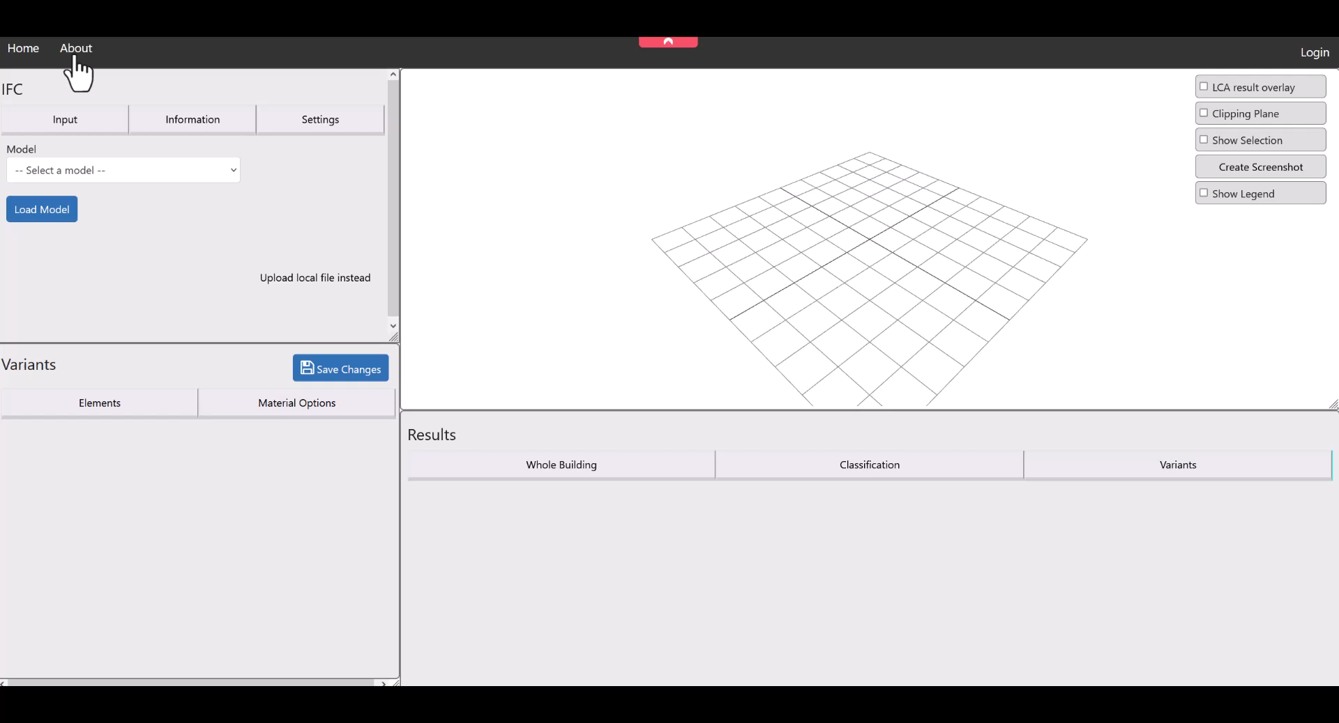
BIM4EarlyLCA: design decision support
Forth, K.; Hollberg, A.; Borrmann, A. (2023): BIM4EarlyLCA: An interactive visualization approach for early design support based on uncertain LCA results using open BIM. Developments in the Built Environment 16

Slide 21
Conclusion PhD
Automation
Fully automated
Semi-automated
LCA
Decision assistance
Unstructured
(EPEA)
No fine-tuning
Pre-structured
(NREL)
MP
Monolingual fine-tuning
Detailed structured
(LKdb)
BEPS
Multilingual fine-tuning
Database structure
LLM fine-tuning

Slide 22
Outlook – workshop focus
Comparing different LLM-based workflows for matching the LCA material dataset to IfcMaterials
Activity III
STS-based
matching approach
Activity IV
Prompt-based
matching approach
Using text embeddings as raw vectors
Calculates cosine similarity
Static
Using instructional input to the LLM
Context-aware reasoning
Dynamic

Slide 23
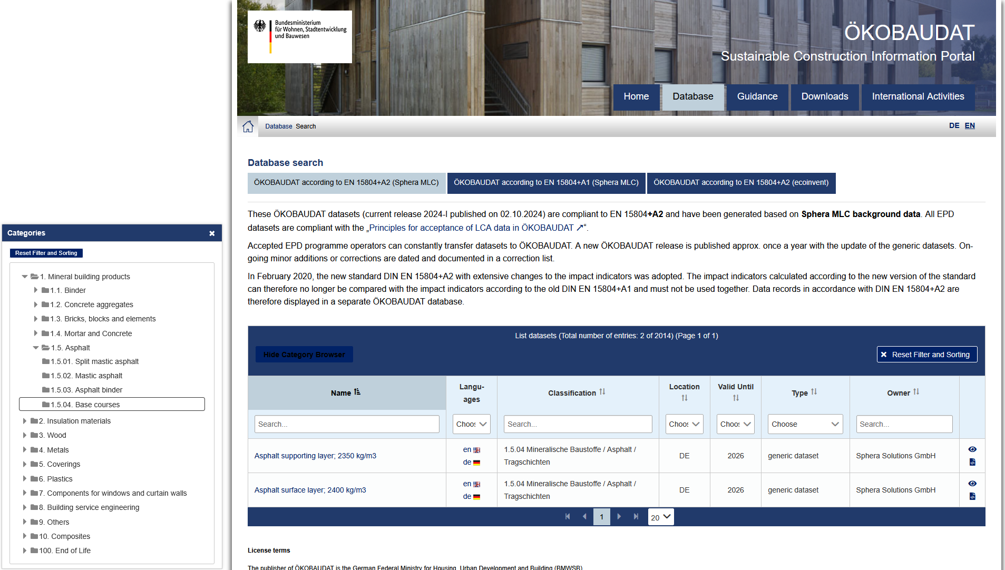
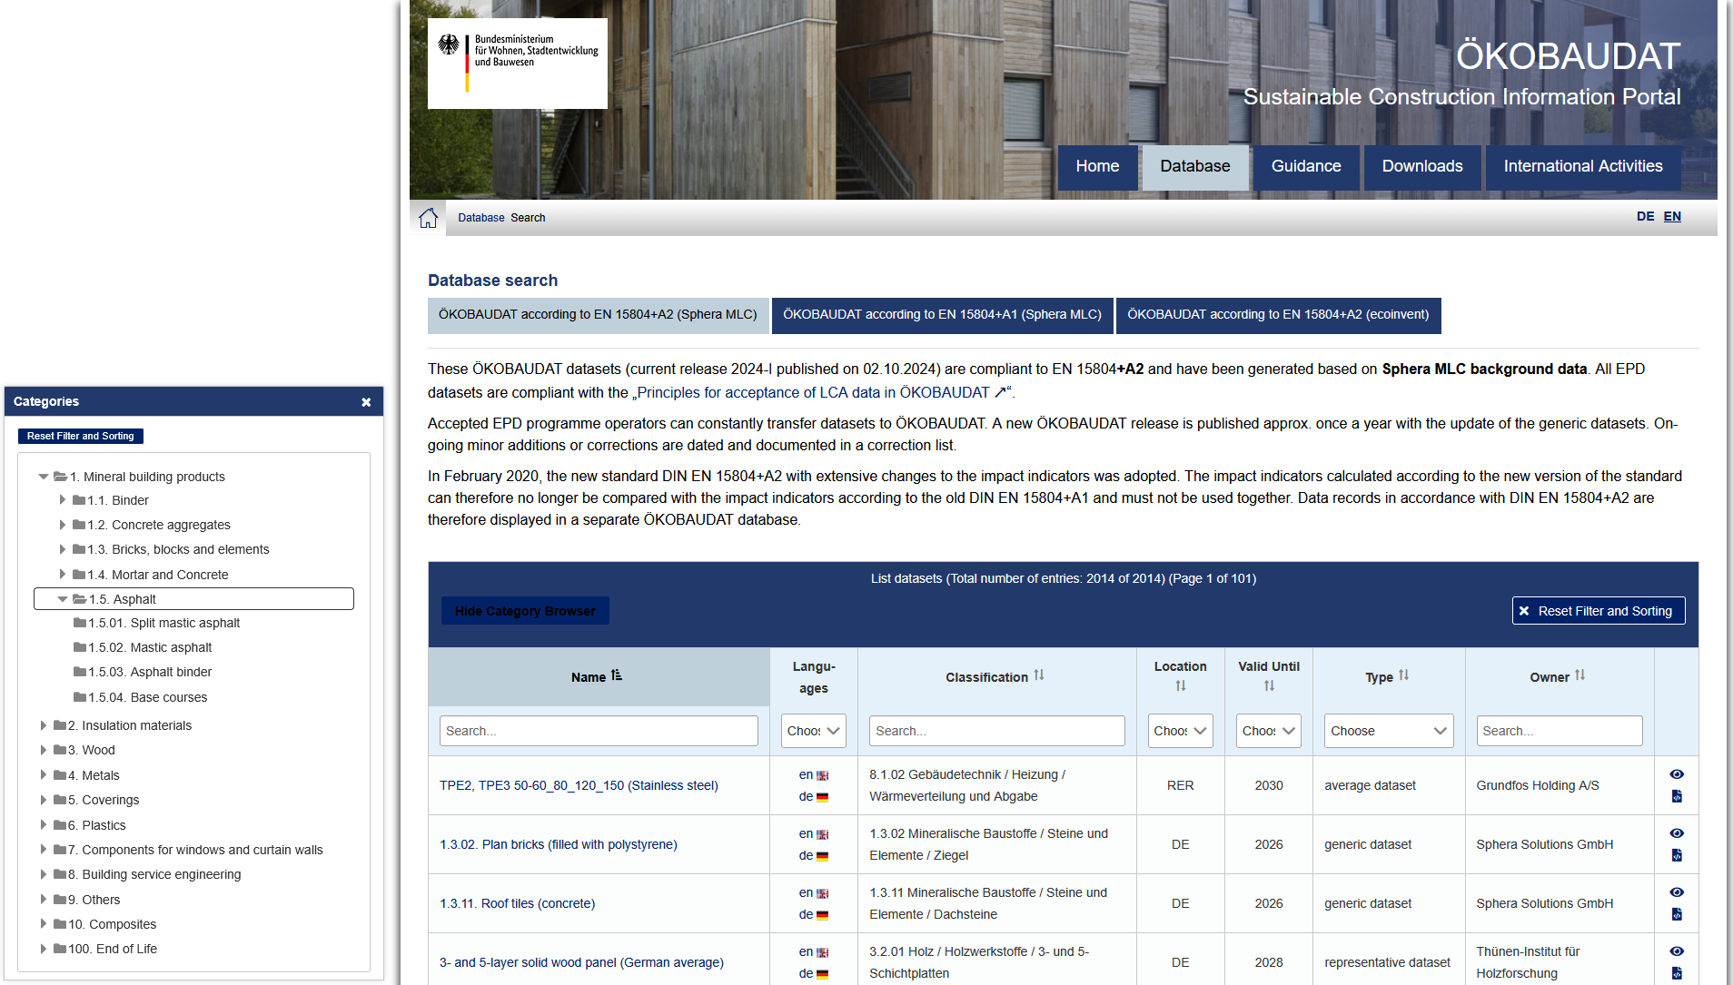
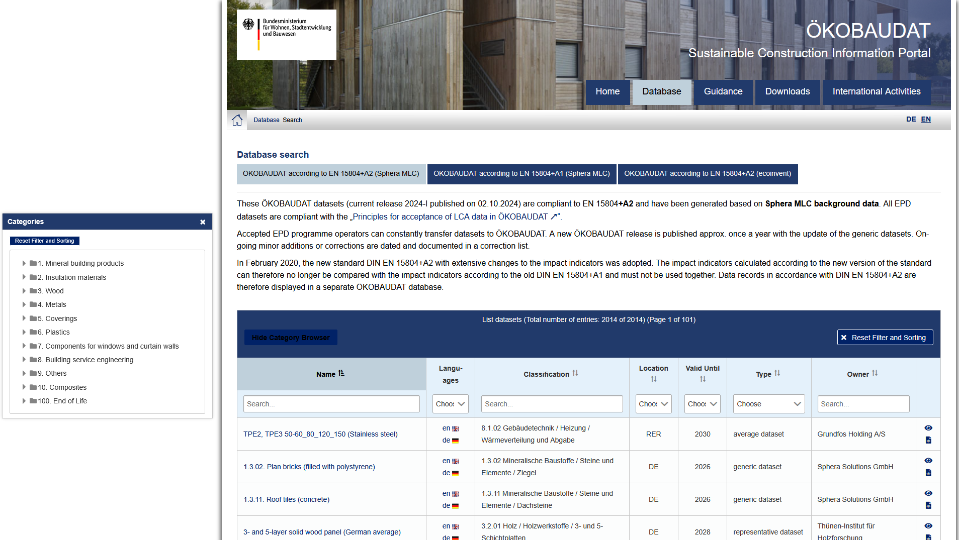
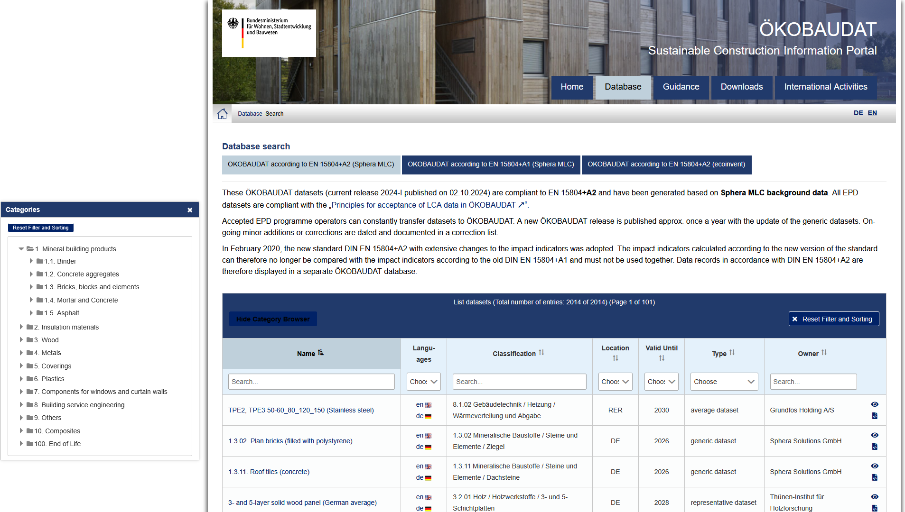
Outlook – workshop
1. Category level
2. Category level
3. Category level
Material dataset level

Slide 24
Thank you!
cea
Circular Engineering for Architecture

